Slide 1
Blocks-World Cameras
Jongho Lee Mohit Gupta
CVPR 2021 (Oral Presentation)

Slide 2
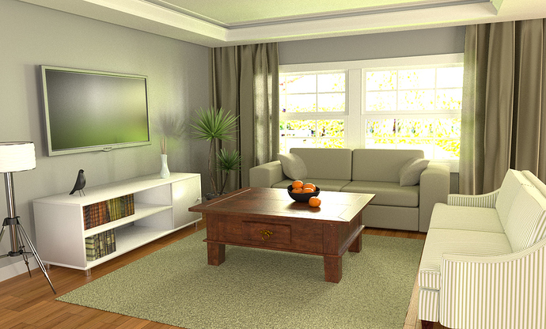
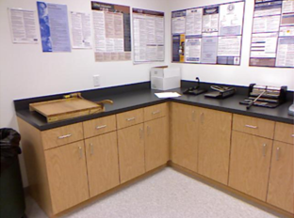
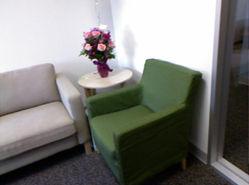
Blocks-World Scenes
Piece-wise planar scenes
Images courtesy: https://blenderartists.org/t/tv-room-indoor-scene/607309, https://cs.nyu.edu/~silberman/datasets/nyu_depth_v2.html

Slide 3
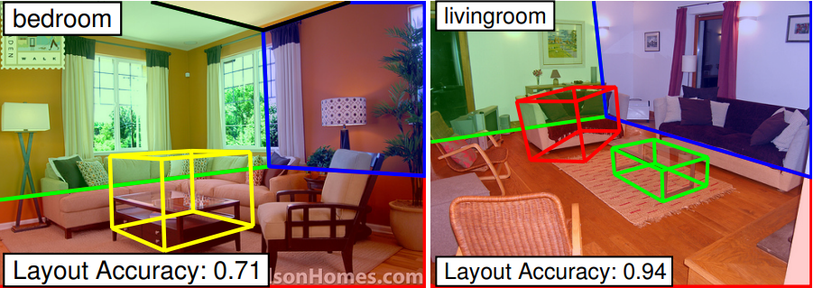
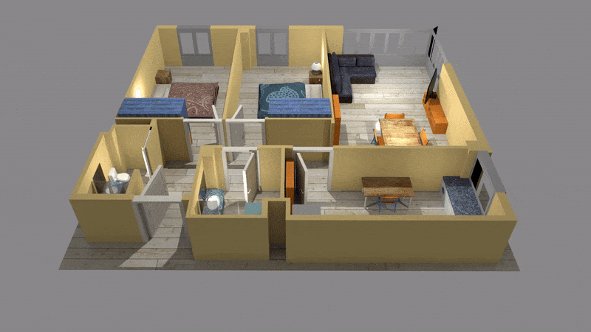
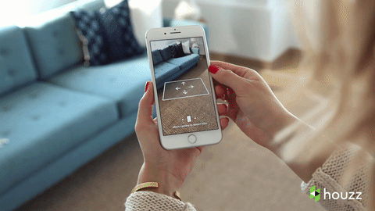
Blocks-World Applications
Navigation
Scene geometry understanding
3D floor plans
AR & VR
Images courtesy: https://www.youtube.com/watch?v=X7IqAHgZlCs&ab_channel=Blippar, Choi et el. CVPR 2013, Understanding Indoor Scenes Using 3D Geometric Phrases, https://www.artstation.com/artwork/wgB1Z, https://mobile-ar.reality.news/news/apple-ar-houzz-arkit-app-beats-ikea-app-store-0180132/

Slide 4
Conventional 3D Cameras
Blocks-World scenes
Cameras
3D point clouds
Detected planes

Slide 5
Conventional 3D Cameras
3D point clouds

Slide 6
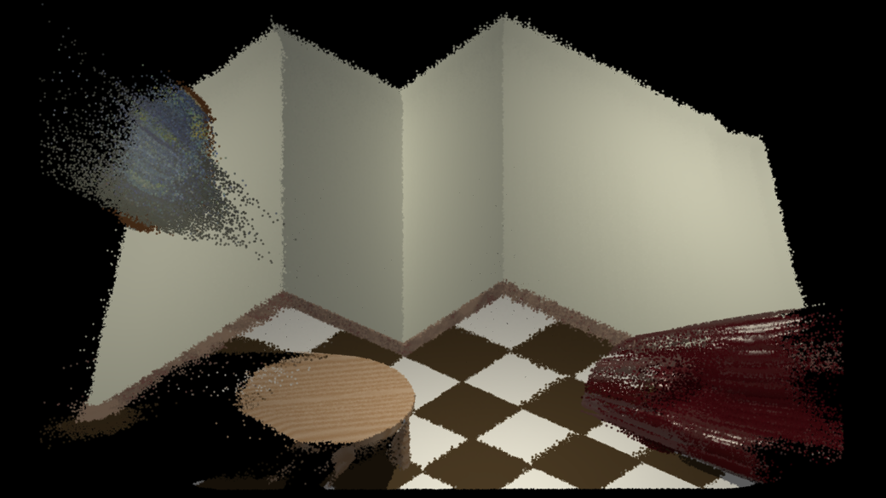
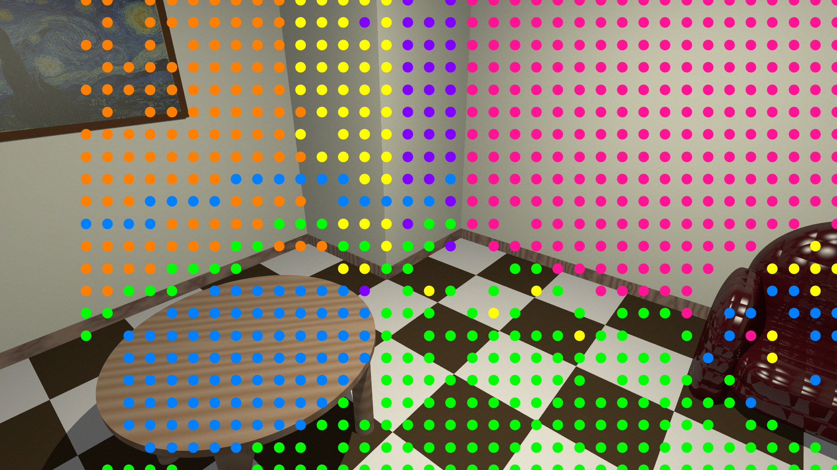
Conventional 3D Cameras
Memory-heavy
Point cloud
Error-prone
Point cloud
Computationally costly &
Inaccurate plane segmentation

Slide 7
Conventional 3D Cameras
Blocks-World scenes
Cameras
3D point clouds
Detected planes
Sensors to recover compact geometry directly at low computational cost?

Slide 8
Blocks-World Cameras
Blocks-World scenes
Cameras
Detected planes
We propose Blocks-World Cameras

Slide 9
Blocks-World Cameras
Blocks-World scene
Blocks-World Camera
Structured-light :
Camera
Projector

Slide 10
Blocks-World Cameras
Blocks-World scene
Camera
Projector

Slide 11
Plane from Known Correspondence
Blocks-World scene
Camera
Projector

Slide 12
Plane from Known Correspondence
Blocks-World scene
Estimated plane
Camera
Projector

Slide 13
Plane from Known Correspondence
?
?
?
?
Correspondence matching?

Slide 14
Plane from Unknown Correspondences
Can we estimate true planes from unknown correspondences?
Yes.

Slide 15
Plane from Unknown Correspondences
Estimated plane
Camera image
Projector pattern

Slide 16
Plane from Unknown Correspondences
Plane parameter space
$$θ$$
Camera image
Projector pattern
$$D$$
$$φ$$

Slide 17
Plane from Unknown Correspondences
Plane parameter space
$$θ$$
Locus of candidate planes
d
a
b
c
d
c
b
Camera image
Projector pattern
a
$$D$$
$$φ$$

Slide 18
Plane from Unknown Correspondences
Plane parameter space
$$θ$$
Locus of candidate planes
Camera image
Projector pattern
$$D$$
$$φ$$

Slide 19
Plane from Unknown Correspondences
Plane parameter space
$$θ$$
Locus of candidate planes
Locus of candidate planes
Camera image
Projector pattern
$$D$$
What we hope…
$$φ$$

Slide 20
Plane from Unknown Correspondences
Plane parameter space
$$θ$$
In reality,
Large overlap…
Camera image
Projector pattern
$$D$$
$$φ$$
Why?

Slide 21
Key Observation
Plane parameter space
$$θ$$
$$D$$
Projector pattern
$$φ$$

Slide 22
Key Observation
Plane parameter space
Uniform
$$θ$$
Large overlap
$$D$$
Projector pattern
$$φ$$
Large overlap with uniform pattern

Slide 23
Key Observation
Plane parameter space
Non-uniform
$$θ$$
$$D$$
Single overlap at true plane
Projector pattern
$$φ$$
Single overlap with non-uniform pattern

Slide 24
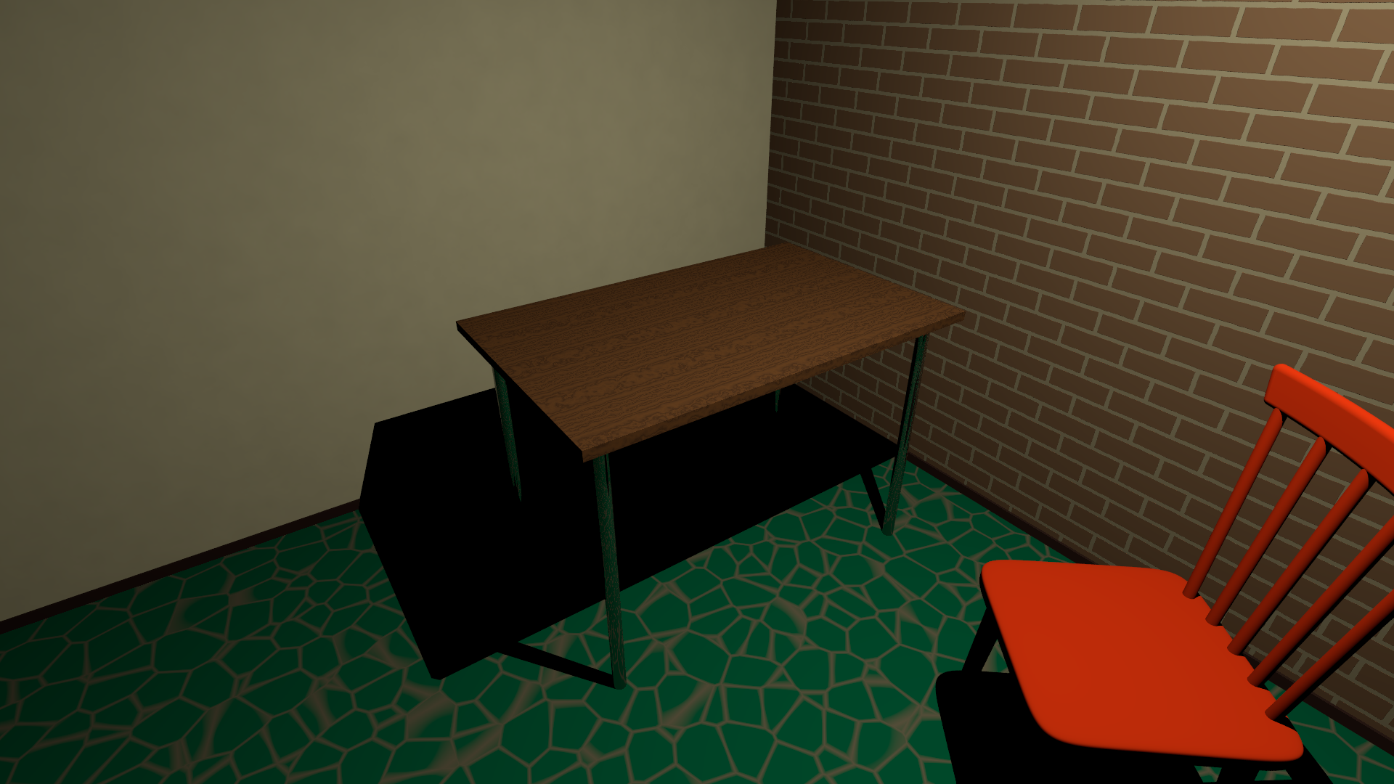
Example

Slide 25
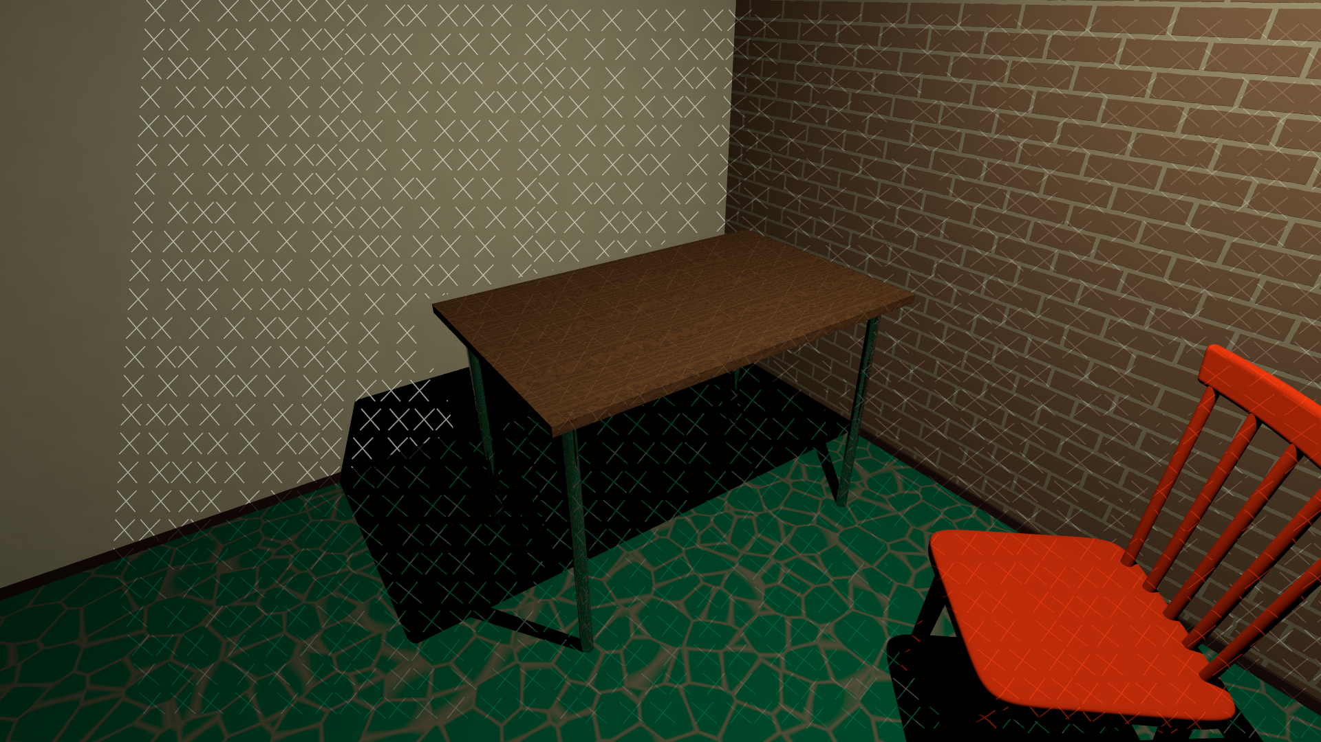
Example

Slide 26
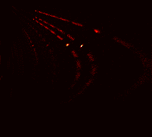
Example
$$θ$$
$$D$$
Plane parameter space

Slide 27
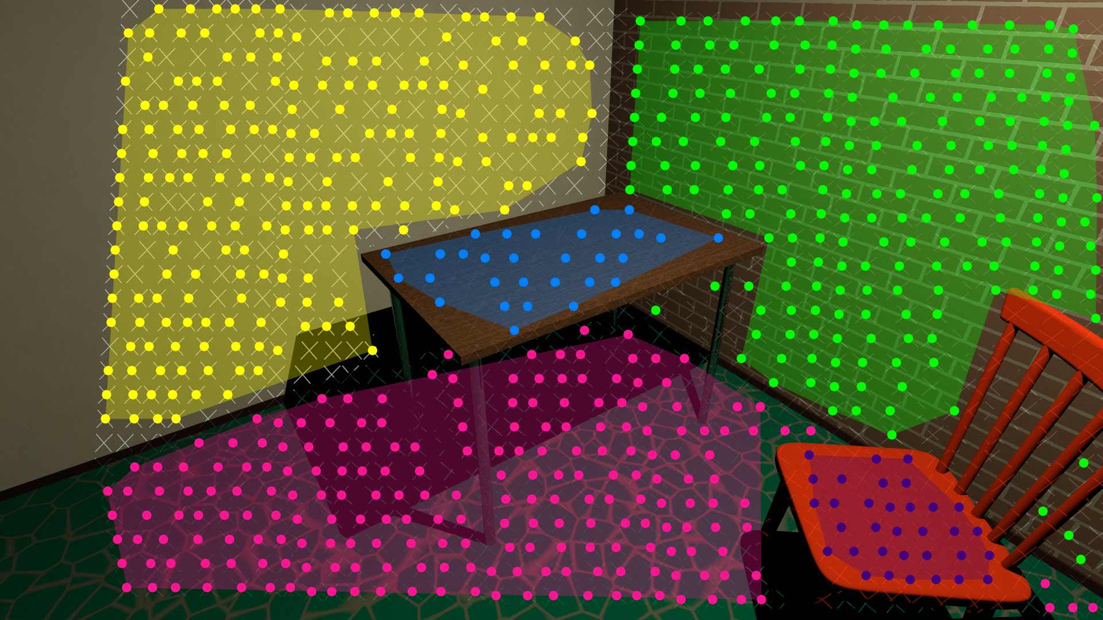
Example
$$Π_{5}$$
$$Π_{5}$$
$$Π_{4}$$
$$Π_{1}$$
$$Π_{4}$$
$$θ$$
$$Π_{1}$$
$$Π_{2}$$
$$Π_{3}$$
$$Π_{3}$$
$$Π_{2}$$
$$D$$
Plane parameter space

Slide 28
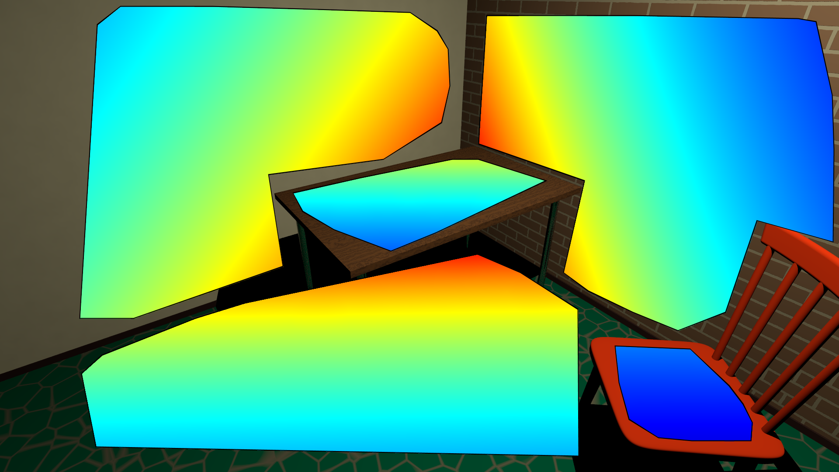
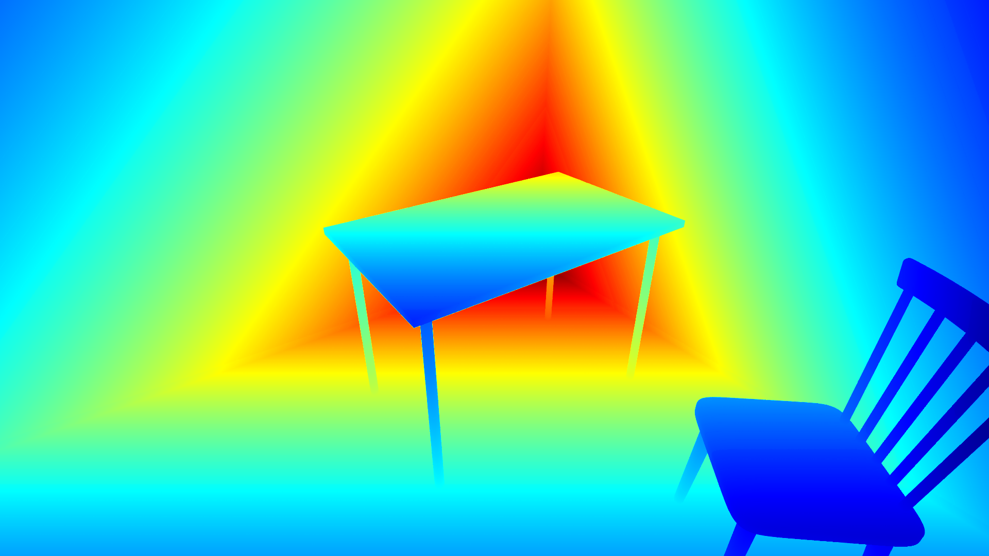
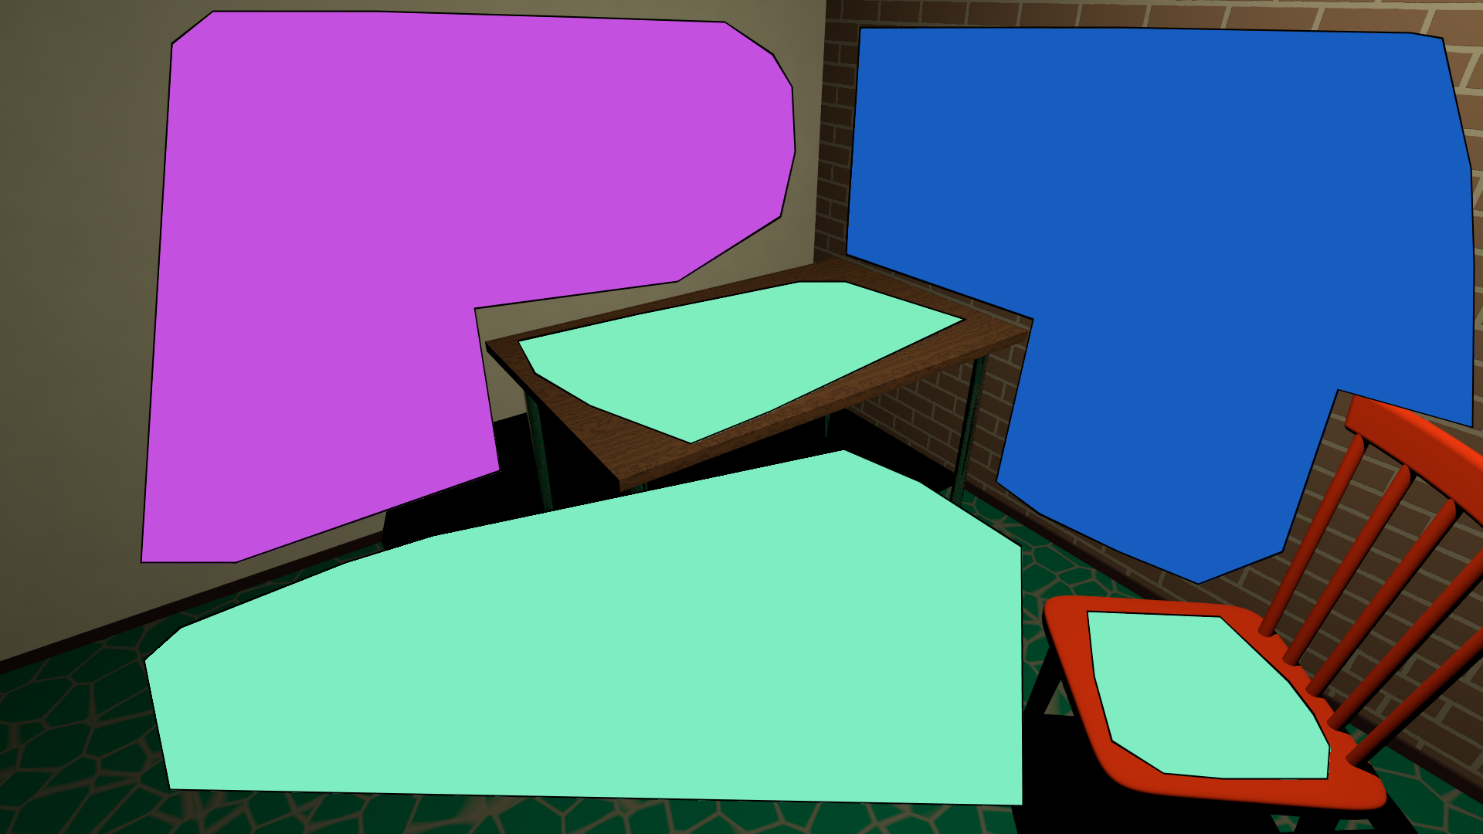
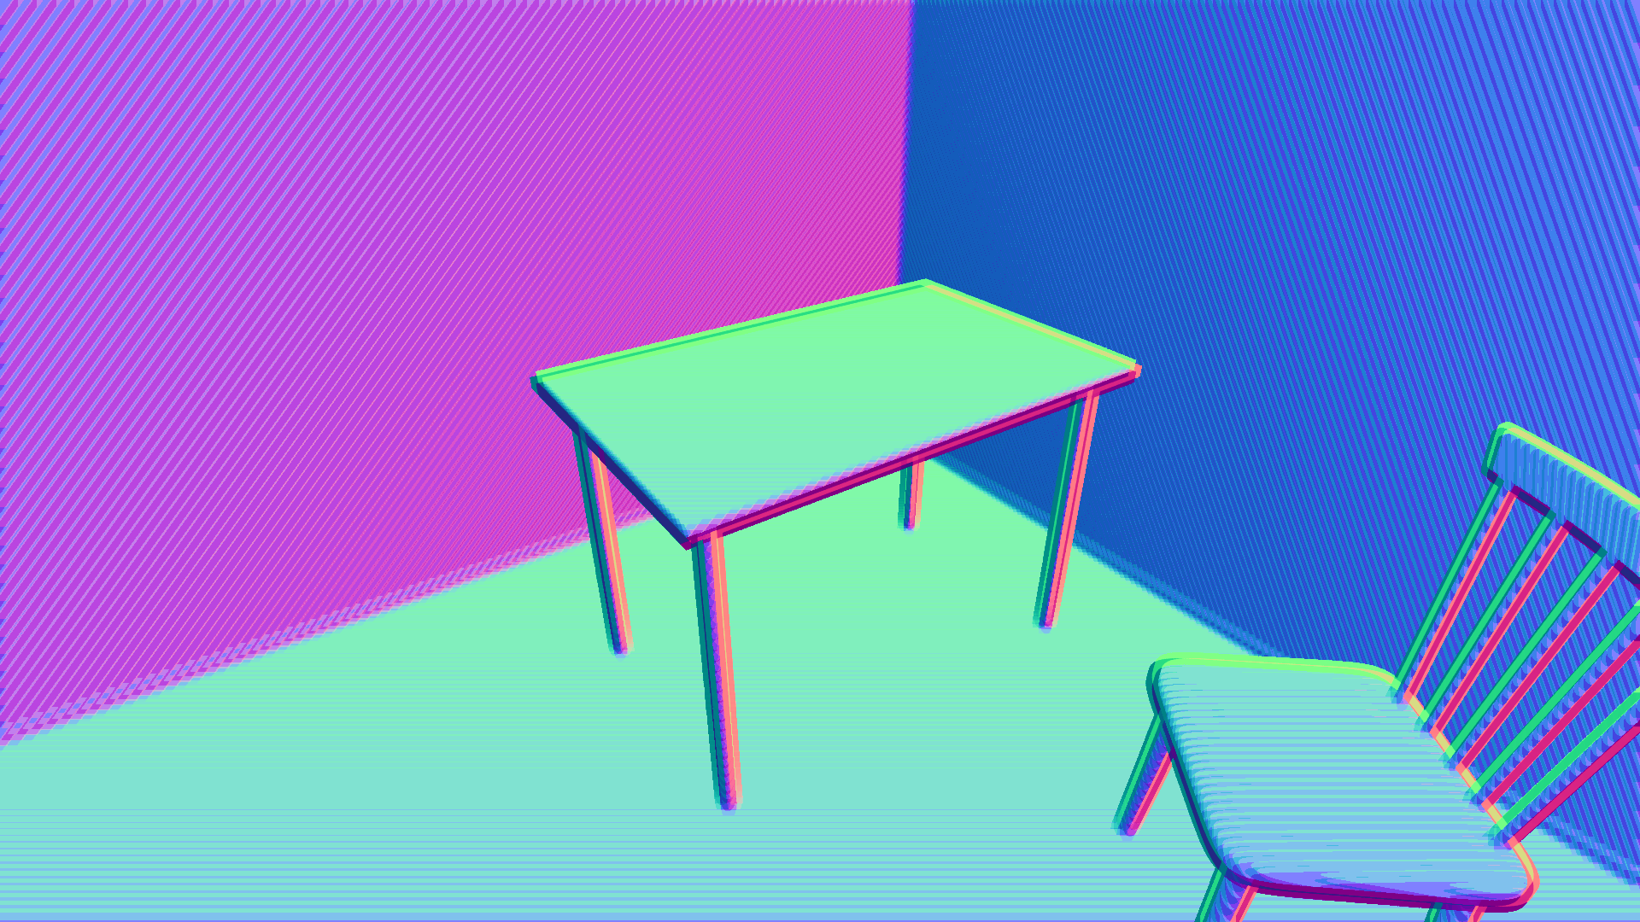
Ground Truth Comparison
Recovered scene geometry
Ground truth scene geometry
$$3.6m$$
$$3.6m$$
Plane depths
$$1.1m$$
$$1.1m$$
Plane normals

Slide 29
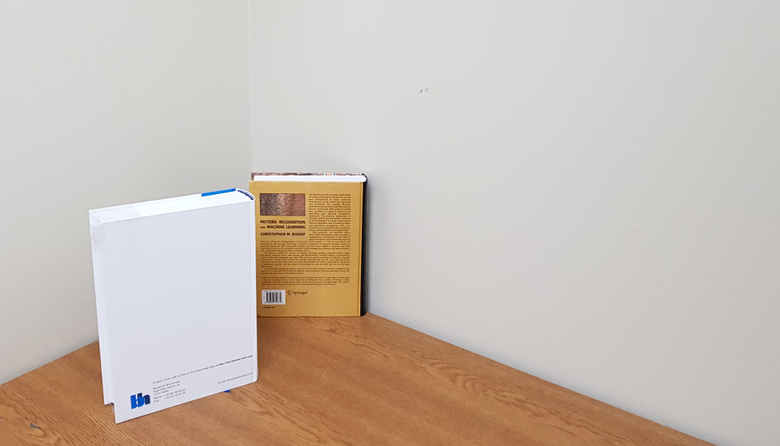
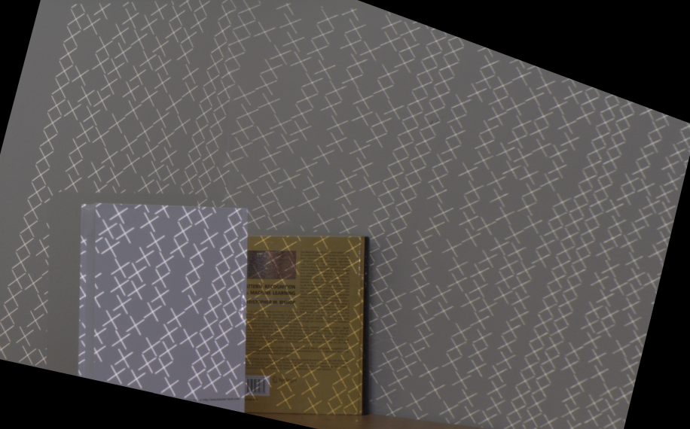
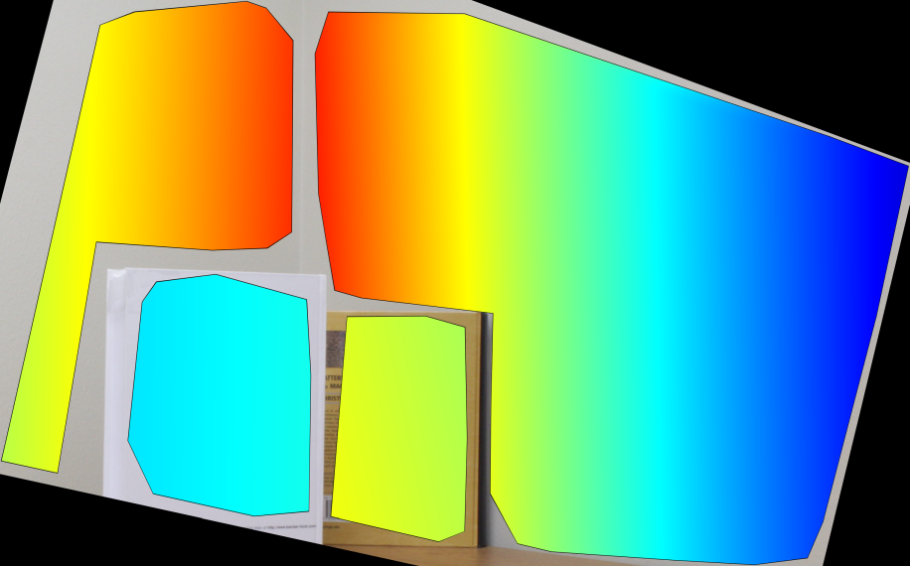
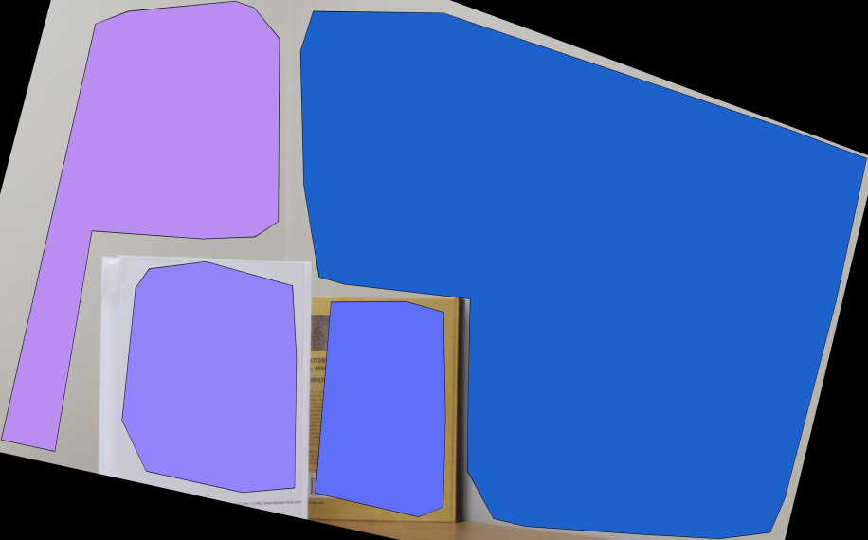
Real Experiments: Robustness to Defocus Blur
Blocks-world scene
Pattern-projected scene
$$1.6m$$
$$1.0m$$
Measured plane depths
Measured plane normals

Slide 30
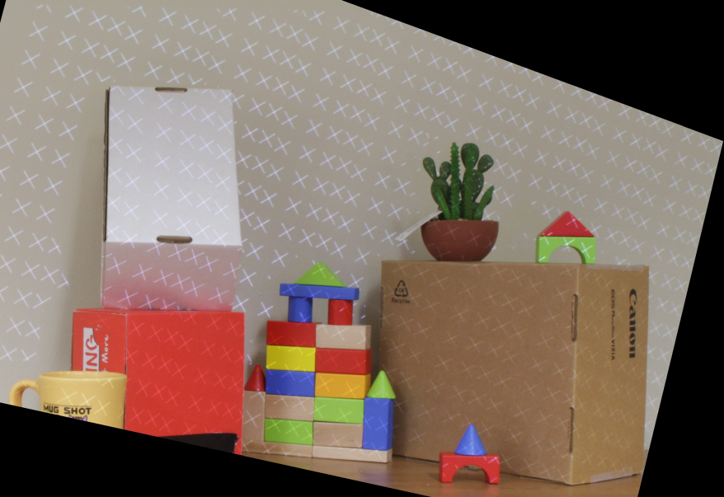
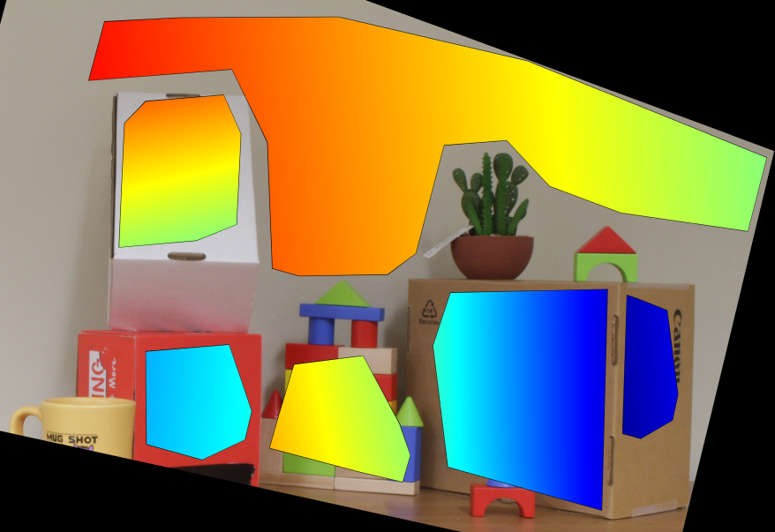
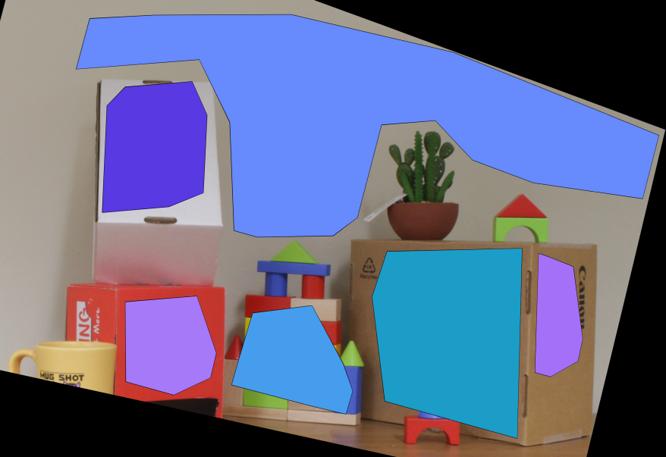
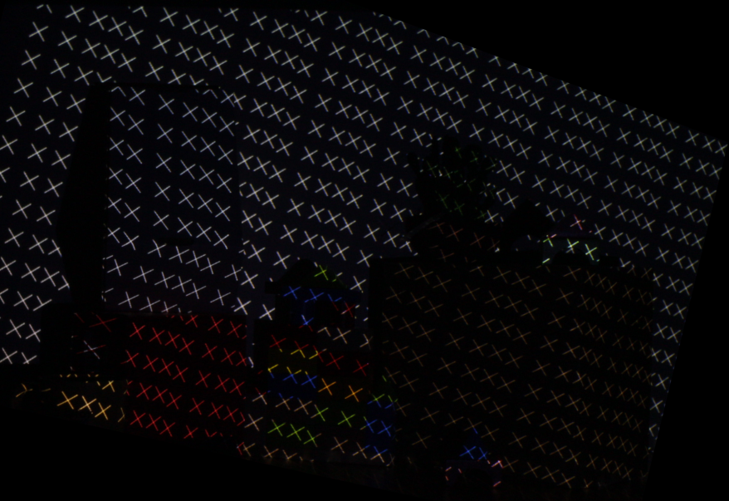
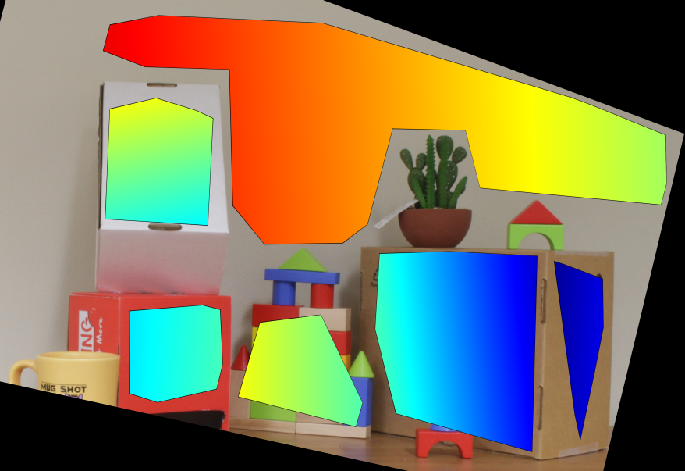
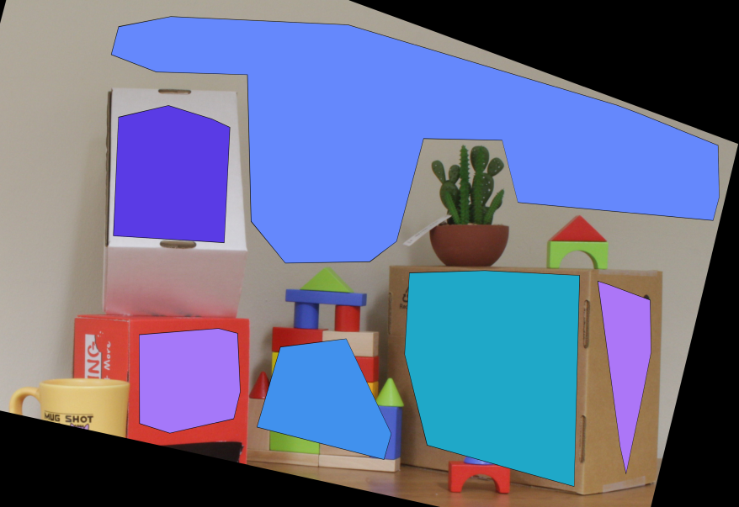
Real Experiments: Robustness to Ambient Light
Light ON
$$1.4m$$
$$1.0m$$
Light OFF
$$1.4m$$
$$1.0m$$
Pattern-projected scenes
Measured plane depths
Measured plane depths

Slide 31
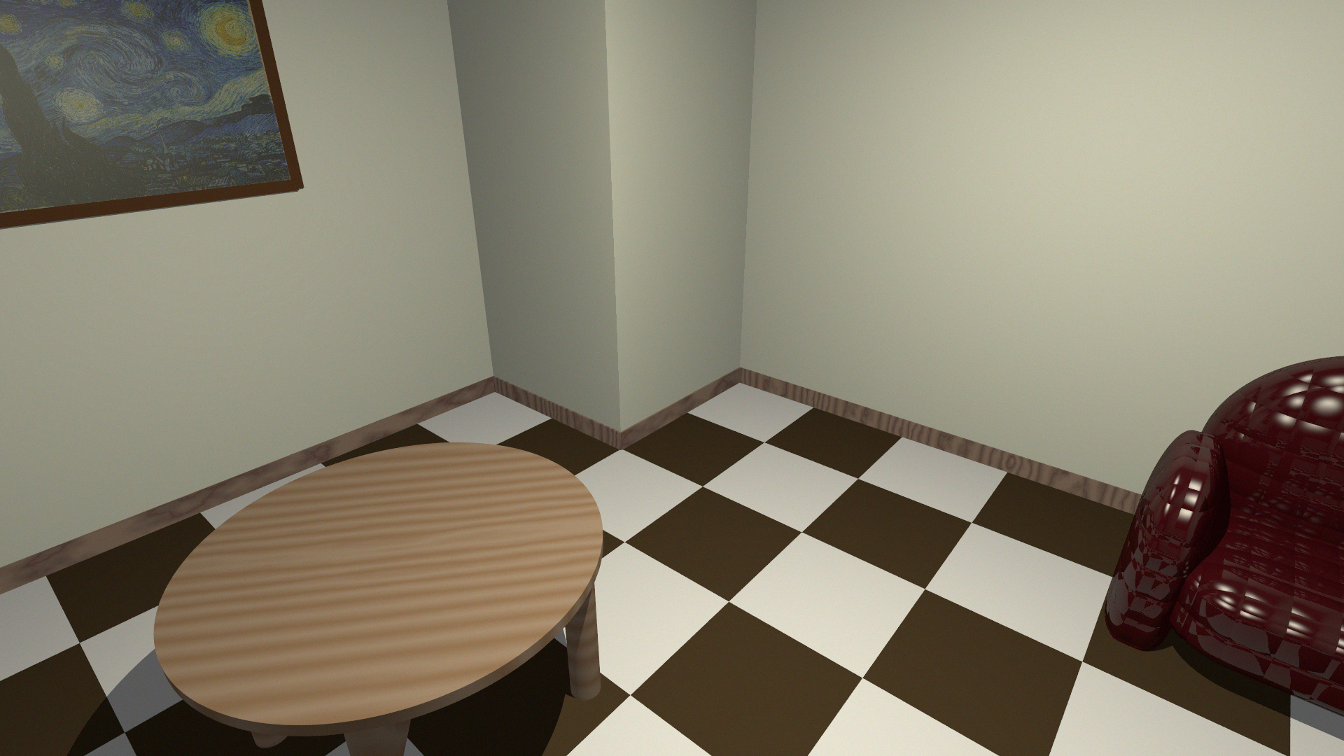
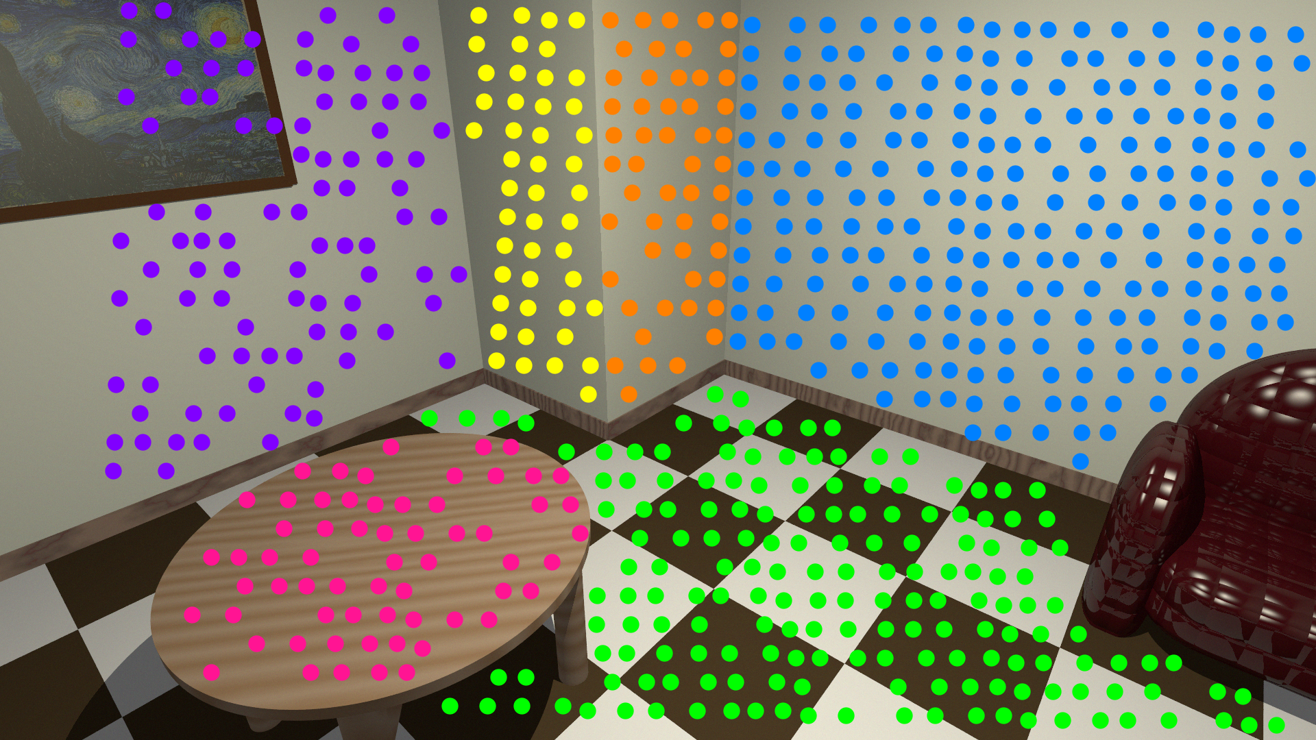
Summary
Conventional 3D cameras
Blocks-World Cameras
Cameras
3D point clouds
Detected planes
Cameras
Detected planes
Blocks-World scenes
Memory-heavy &
error-prone point clouds
Computationally costly &
inaccurate plane detection
Compute efficient &
accurate plane detection
Blocks-World Cameras: sensors for memory-efficient, fast and accurate planar scene detection
http://wisionlab.cs.wisc.edu/project/bwc/

