Slide 1
CASPI: Collaborative Photon Processing for Active Single-Photon Imaging
Jongho Lee, Atul Ingle, Jenu Chacko, Kevin Eliceiri, Mohit Gupta
University of Wisconsin-Madison

Slide 2
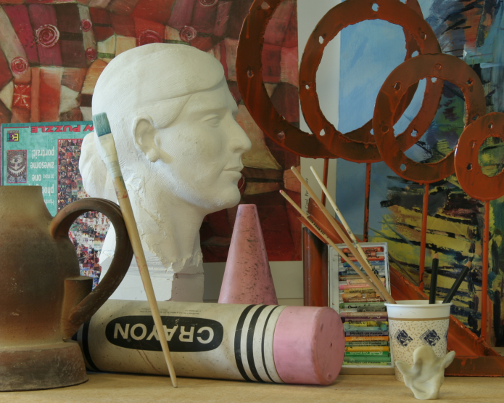

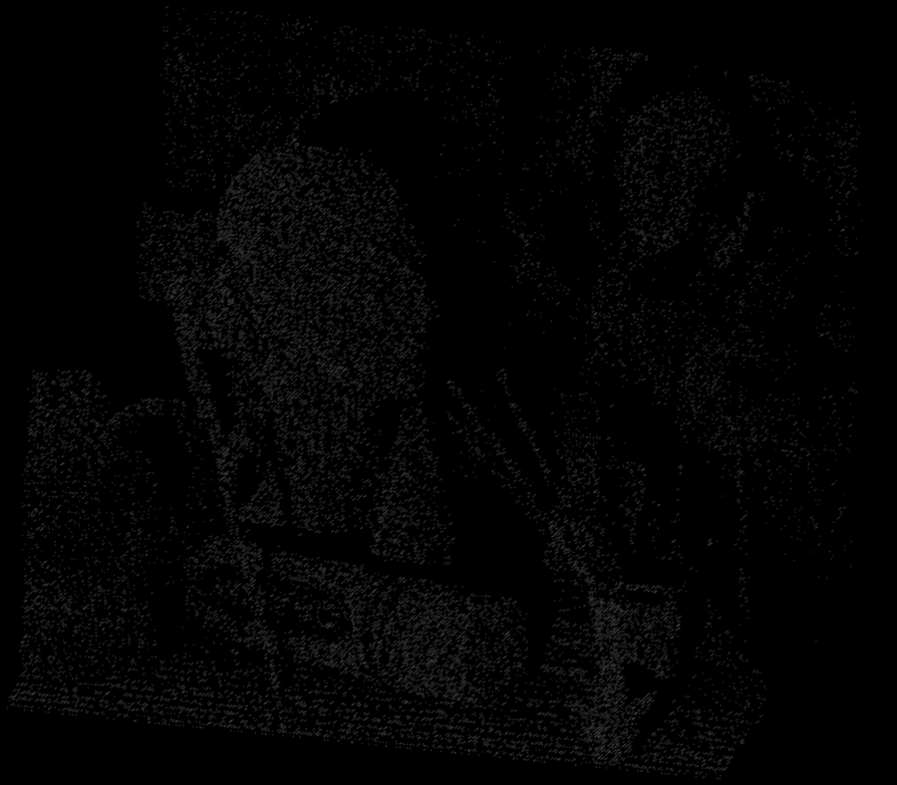
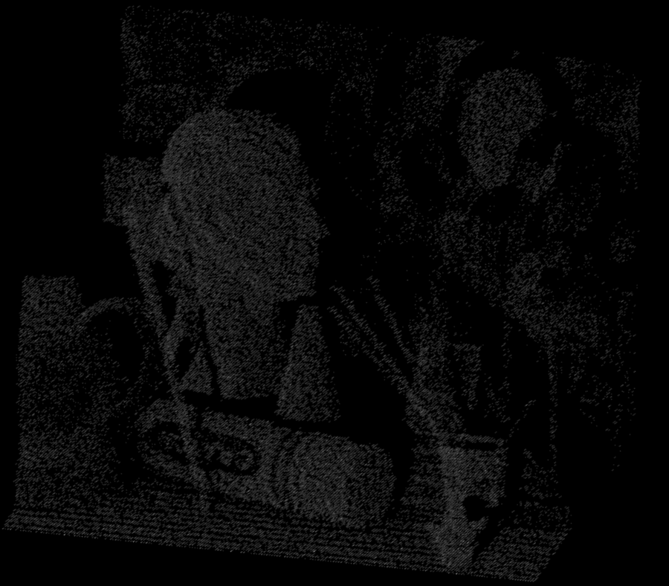
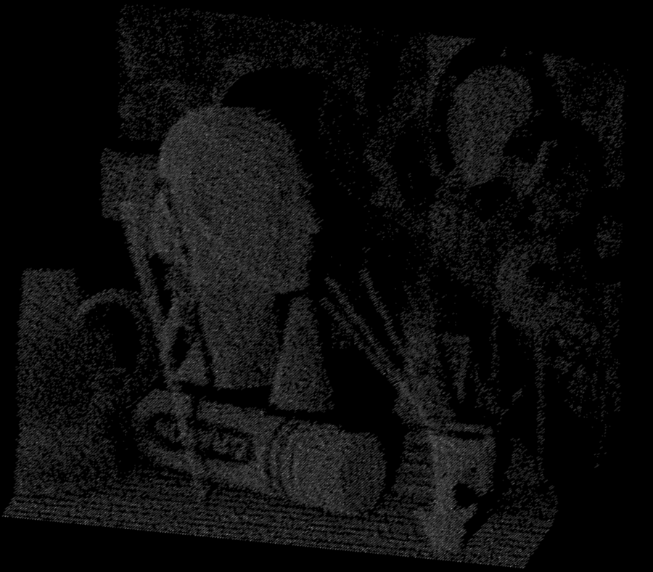


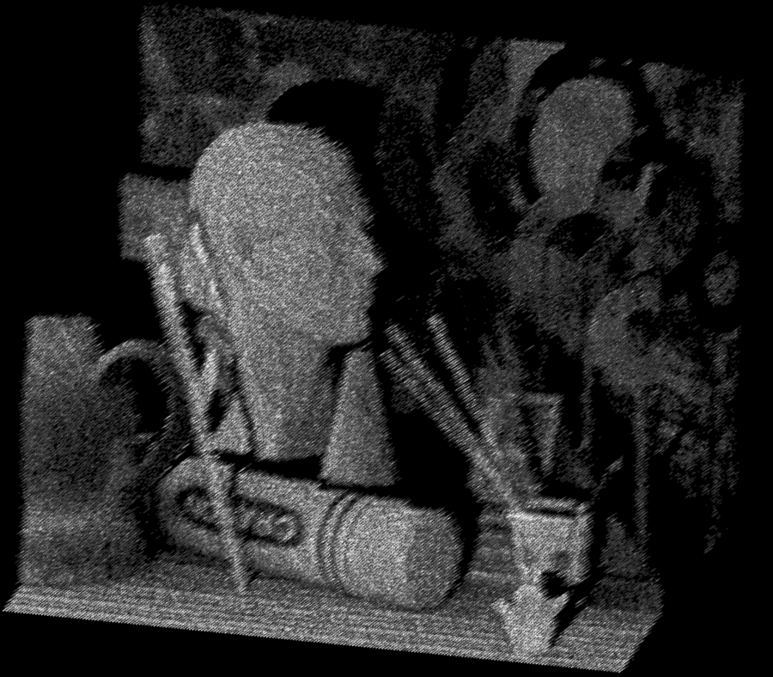
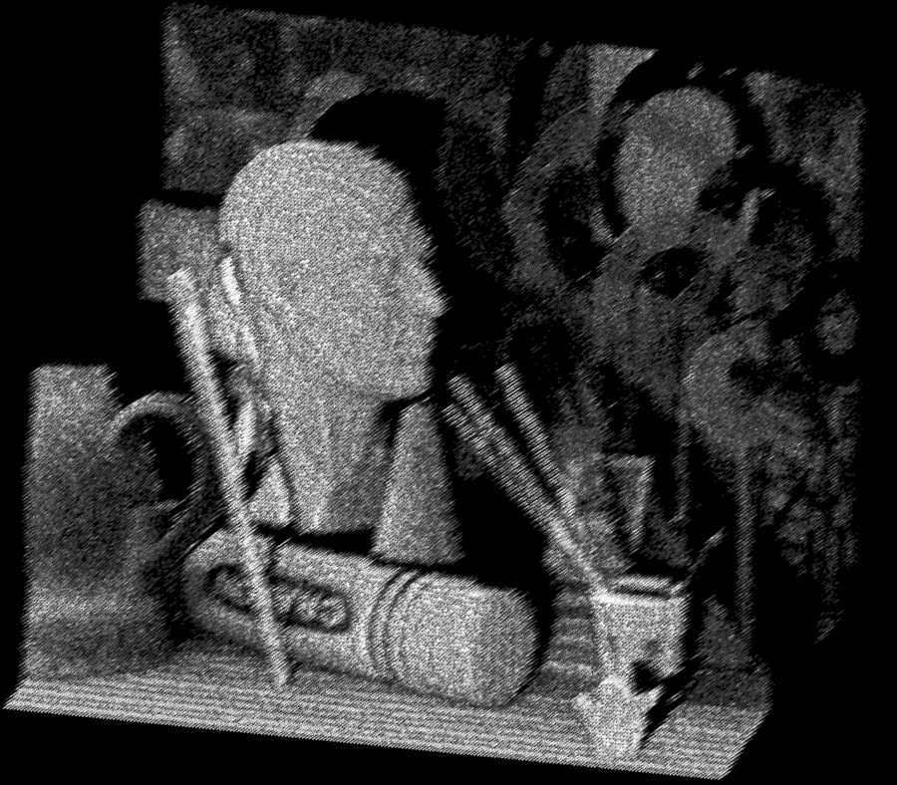
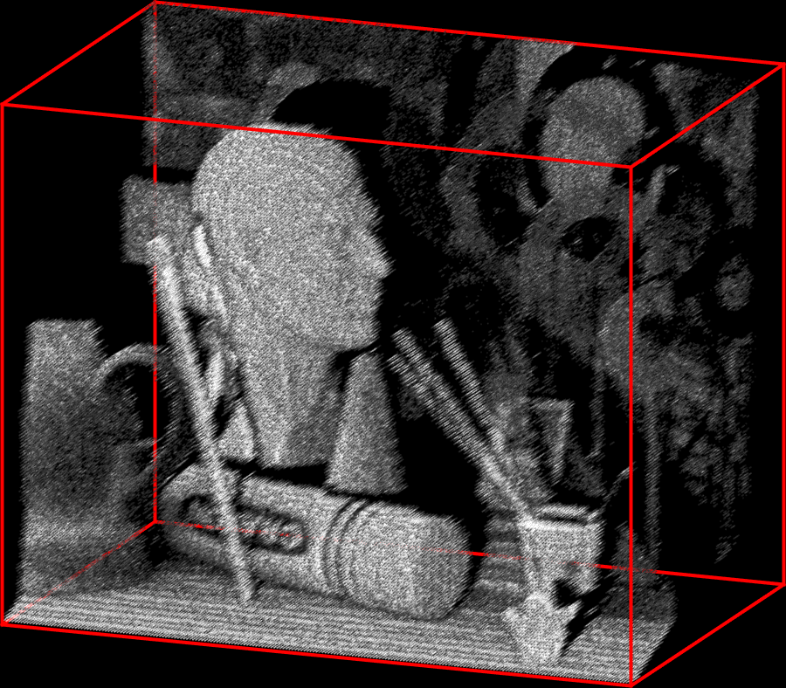



Active Single-Photon Imaging
Scene
$$t$$
3D photon transient cube
$$x$$
$$y$$
Light source
Single-photon camera
9

Slide 3



Measurable Property: Depth
$$t$$
3D photon transient cube
Photon histogram
$$x$$
$$y$$
Scene depth
Photon counts
Time

Slide 4
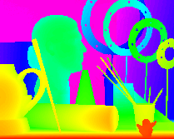


Measurable Property: Depth
$$t$$
3D photon transient cube
Depth map
$$x$$
$$y$$
$$1.40$$
Depth (m)
$$2.17$$

Slide 5
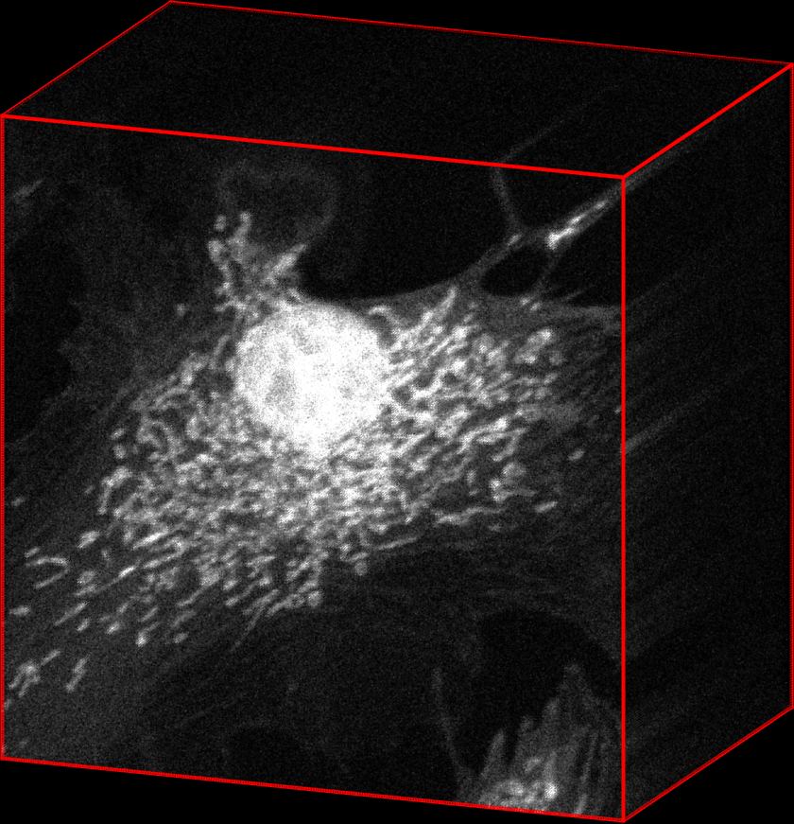



Measurable Property: Fluorescence Lifetime
$$t$$
3D photon transient cube
Photon histogram
$$x$$
$$y$$
Photon counts
Fluorescence lifetime
Time

Slide 6
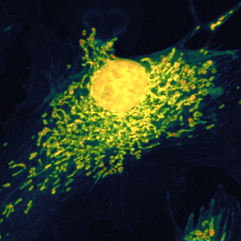


Measurable Property: Fluorescence Lifetime
$$t$$
3D photon transient cube
Lifetime image
$$x$$
$$y$$
$$1.5$$
Lifetime (ns)
$$3.4$$

Slide 7
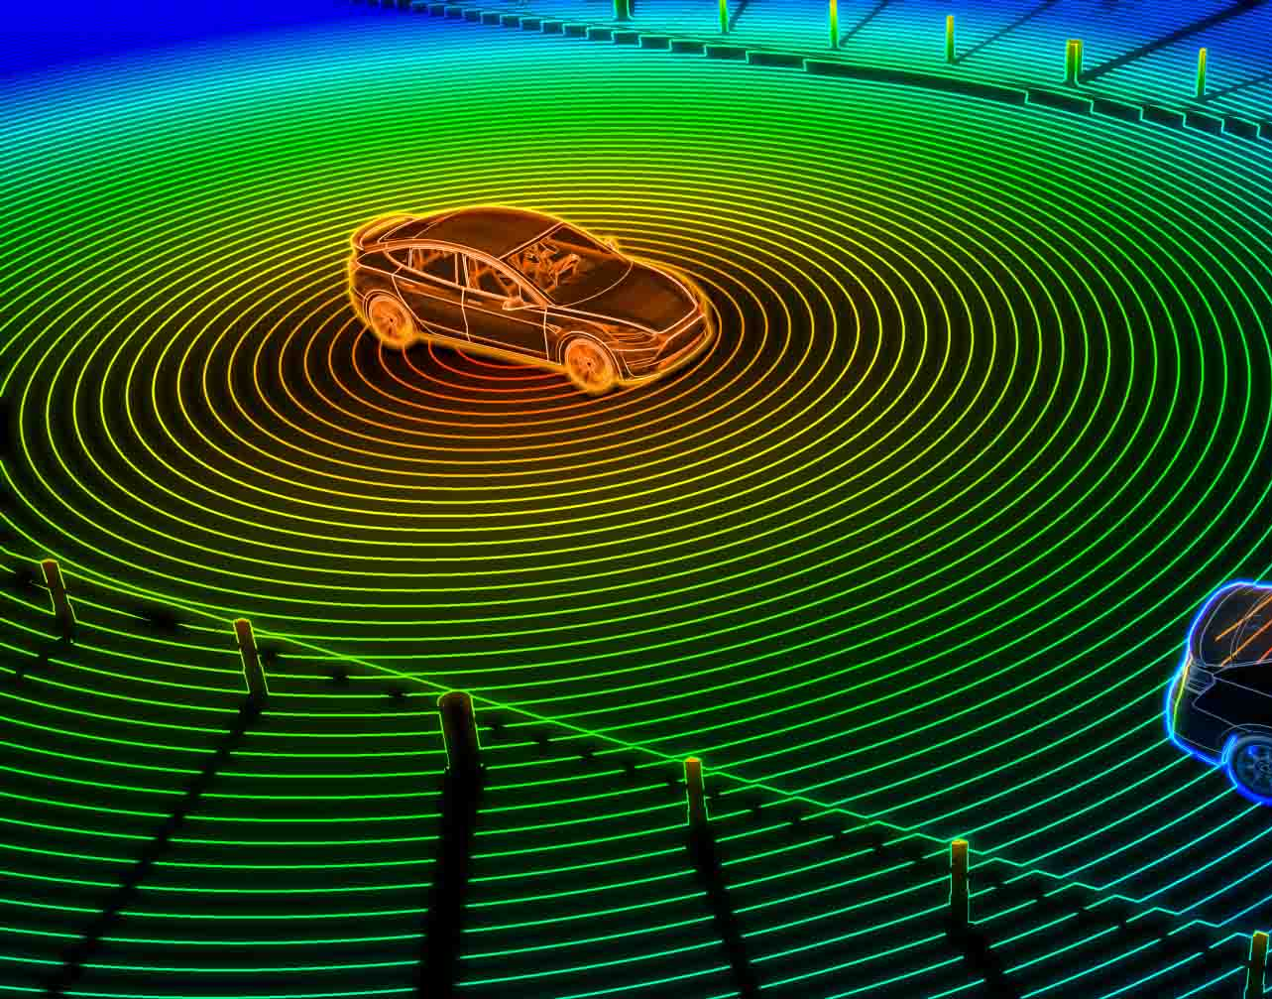
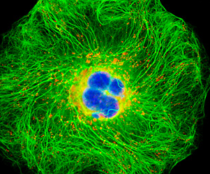
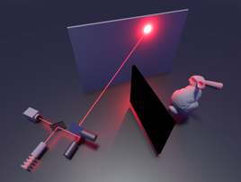
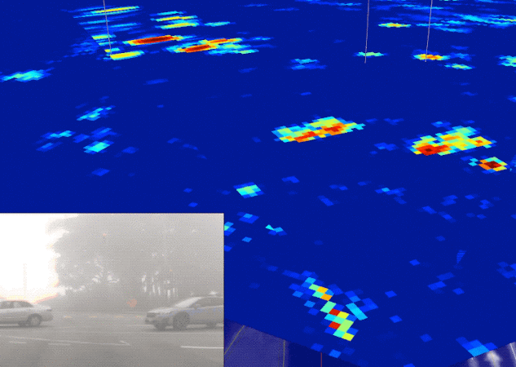
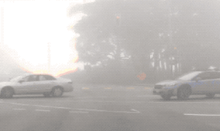
Various Active Single-Photon Applications
LiDAR
Fluorescence microscopy
NLOS imaging
Imaging through scattering
https://waymo.com/blog/2021/11/a-fog-blog.html
https://denso-x.com/stories/how-lidar-technology-is-shaping-our-lives/
https://micro.magnet.fsu.edu/primer/techniques/fluorescence/gallery/cells/a549/a549cells.html
https://news.stanford.edu/2018/03/05/technique-can-see-objects-hidden-around-corners/

Slide 8
Various Active Single-Photon Applications
LiDAR
Fluorescence microscopy
NLOS imaging
Imaging through scattering
https://waymo.com/blog/2021/11/a-fog-blog.html
https://denso-x.com/stories/how-lidar-technology-is-shaping-our-lives/
https://micro.magnet.fsu.edu/primer/techniques/fluorescence/gallery/cells/a549/a549cells.html
https://news.stanford.edu/2018/03/05/technique-can-see-objects-hidden-around-corners/
Indirect light
Signal
Depth
Intensity
Intensity
Intensity
Intensity
Lifetime
Time
Time
Time
Time
Scene properties are in temporal photon transients

Slide 9


Challenges
3D photon transient cube
Depth map
$$1.40$$
Depth (m)
$$2.17$$

Slide 10
Challenges
3D photon transient cube
Depth map
Weak background
9
$$1.40$$
Depth (m)
$$2.17$$
Strong light source
Reliable scene properties only with strong signal & weak background

Slide 11
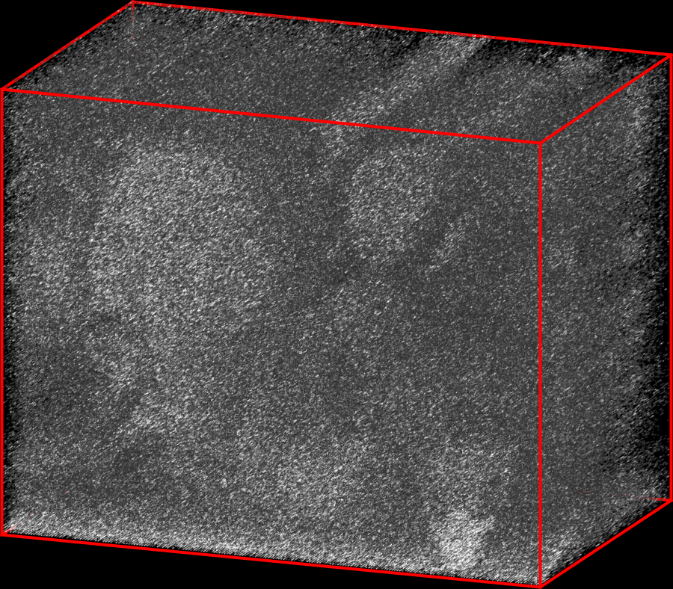
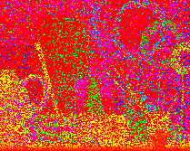
Challenges
3D photon transient cube
Depth map
High background
$$1.40$$
Depth (m)
$$2.17$$
Unreliable scene properties with high background light

Slide 12
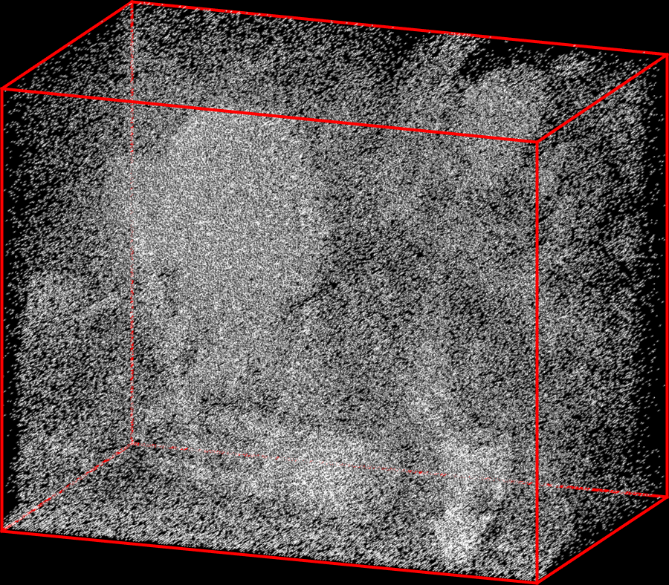
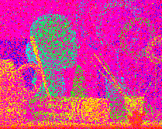
Challenges
3D photon transient cube
Depth map
9
$$1.40$$
Depth (m)
$$2.17$$
Weak light source
Unreliable scene properties with weak signal light

Slide 13

Motivation: Filter Scene Property or Raw Data?
Raw measurement
Estimated depth
Filter after estimating scene properties?

Slide 14
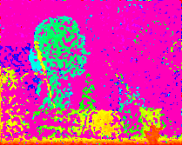

Motivation: Filter Scene Property or Raw Data?
Raw measurement
Estimated depth
Median filtering
BM3D
or
Conventional image filtering does not work in challenging scenarios

Slide 15
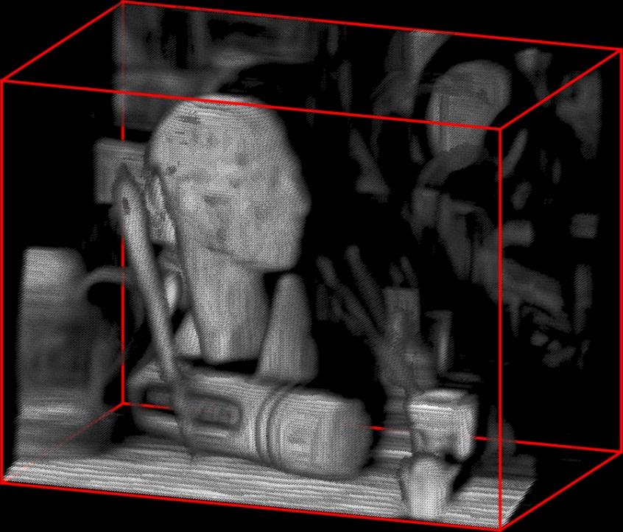
Motivation: Filter Scene Property or Raw Data?
Raw measurement
Estimated depth
Median filtering
BM3D
or
Recover photon flux
How about recovering photon flux first?

Slide 16
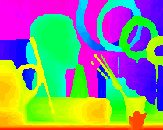
Motivation: Filter Scene Property or Raw Data?
Raw measurement
Estimated depth
Median filtering
BM3D
or
Recover photon flux
Estimated depth
Enables more reliable estimates

Slide 17
Our Goal
Goal: Recover photon fluxes in extremely challenging conditions
CASPI
Collaborative photon processing for Active Single-Photon Imaging
(Lee et el., Nature Communications 2023)

Slide 18









Implications: Extended operating Regimes
$${10}^{2}$$
Without CASPI
$${10}^{1}$$
Signal photons
$${10}^{0}$$
$${10}^{−1}$$
$${10}^{0}$$
$${10}^{1}$$
$${10}^{2}$$
$${10}^{3}$$
$${10}^{4}$$
Background photons

Slide 19
Implications: Extended operating Regimes
$${10}^{2}$$
Without CASPI
$${10}^{1}$$
Signal photons
With CASPI
$${10}^{0}$$
$${10}^{−1}$$
$${10}^{0}$$
$${10}^{1}$$
$${10}^{2}$$
$${10}^{3}$$
$${10}^{4}$$
Background photons

Slide 20




Implications: Various Applications
Example: LiDAR
Photon transient cube
Photon histogram
Depth map
$$t$$
$$x$$
$$y$$
Intensity
Time
CASPI
Scene depth
Intensity
Time

Slide 21
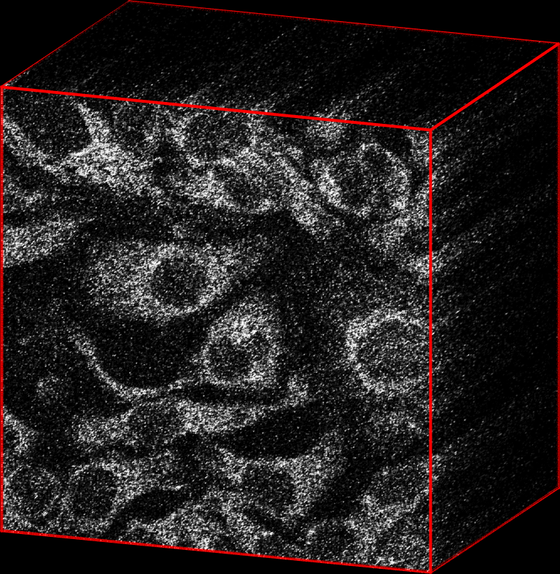
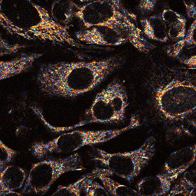
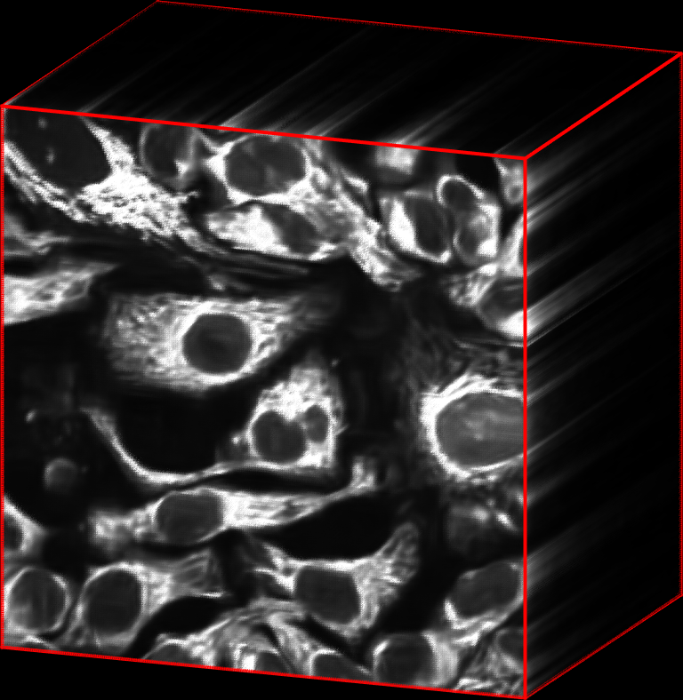
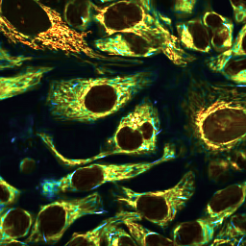



Implications: Various Applications
Example: FLIM
Photon transient cube
Photon histogram
Lifetime images
$$t$$
$$x$$
$$y$$
Intensity
Time
CASPI
Intensity
Lifetime
Time

Slide 22
Implications: Various Applications
LiDAR
Fluorescence microscopy
NLOS imaging
Imaging through scattering
https://waymo.com/blog/2021/11/a-fog-blog.html
https://denso-x.com/stories/how-lidar-technology-is-shaping-our-lives/
https://micro.magnet.fsu.edu/primer/techniques/fluorescence/gallery/cells/a549/a549cells.html
https://news.stanford.edu/2018/03/05/technique-can-see-objects-hidden-around-corners/
Indirect light
Signal
Depth
Intensity
Intensity
Intensity
Intensity
Lifetime
Time
Time
Time
Time
Applicable to other active single-photon applications

Slide 23

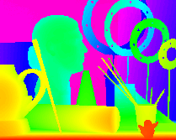
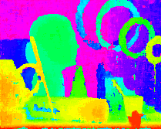
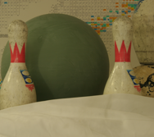

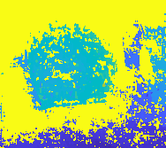


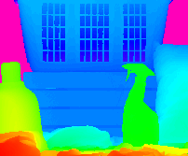
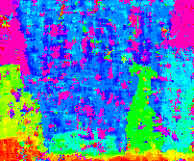
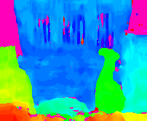



Implications: No Training
Scene
Ground-truth depth
Learning-based
CASPI (ours)
$2/50$
$$10/2000$$
Different SBRs
$$0.2/10$$
Learning is difficult to generalize for various illumination conditions

Slide 24

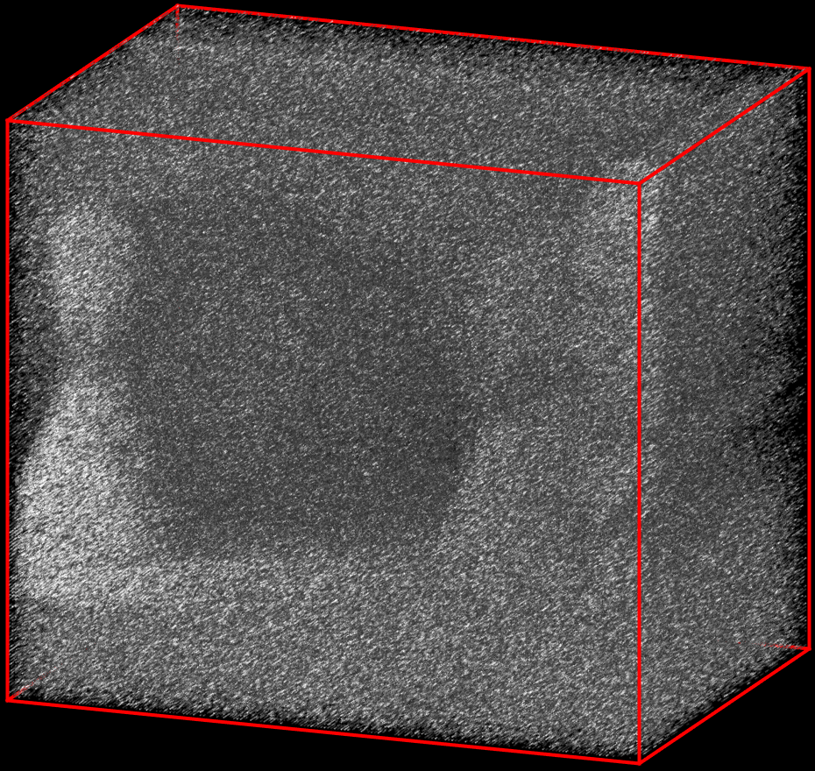

Implications: Complement Conventional Techniques
Statistical
Measurement when SBR: $10/2000$
Ground-truth depth
Scene
Learning-based
Conventional techniques can fail in challenging scenarios

Slide 25

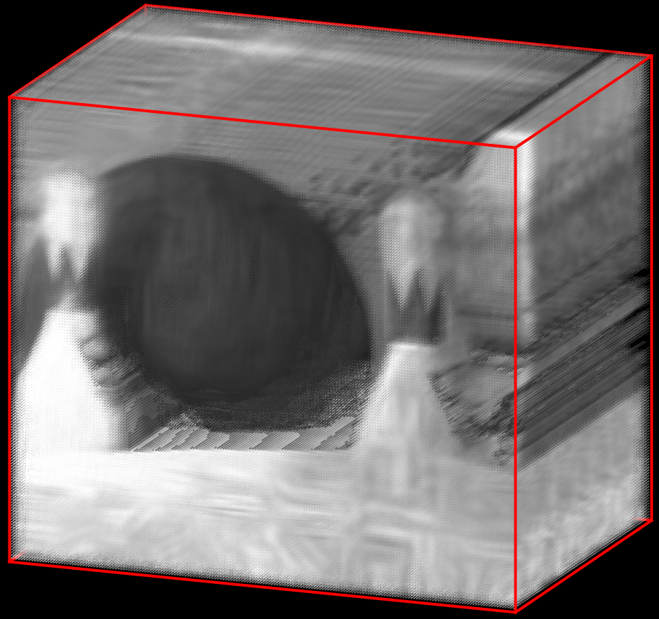

Implications: Complement Conventional Techniques
Statistical
Ground-truth depth
CASPI (ours)
Scene
Learning-based
CASPI complements conventional techniques

Slide 26
Algorithm

Slide 27
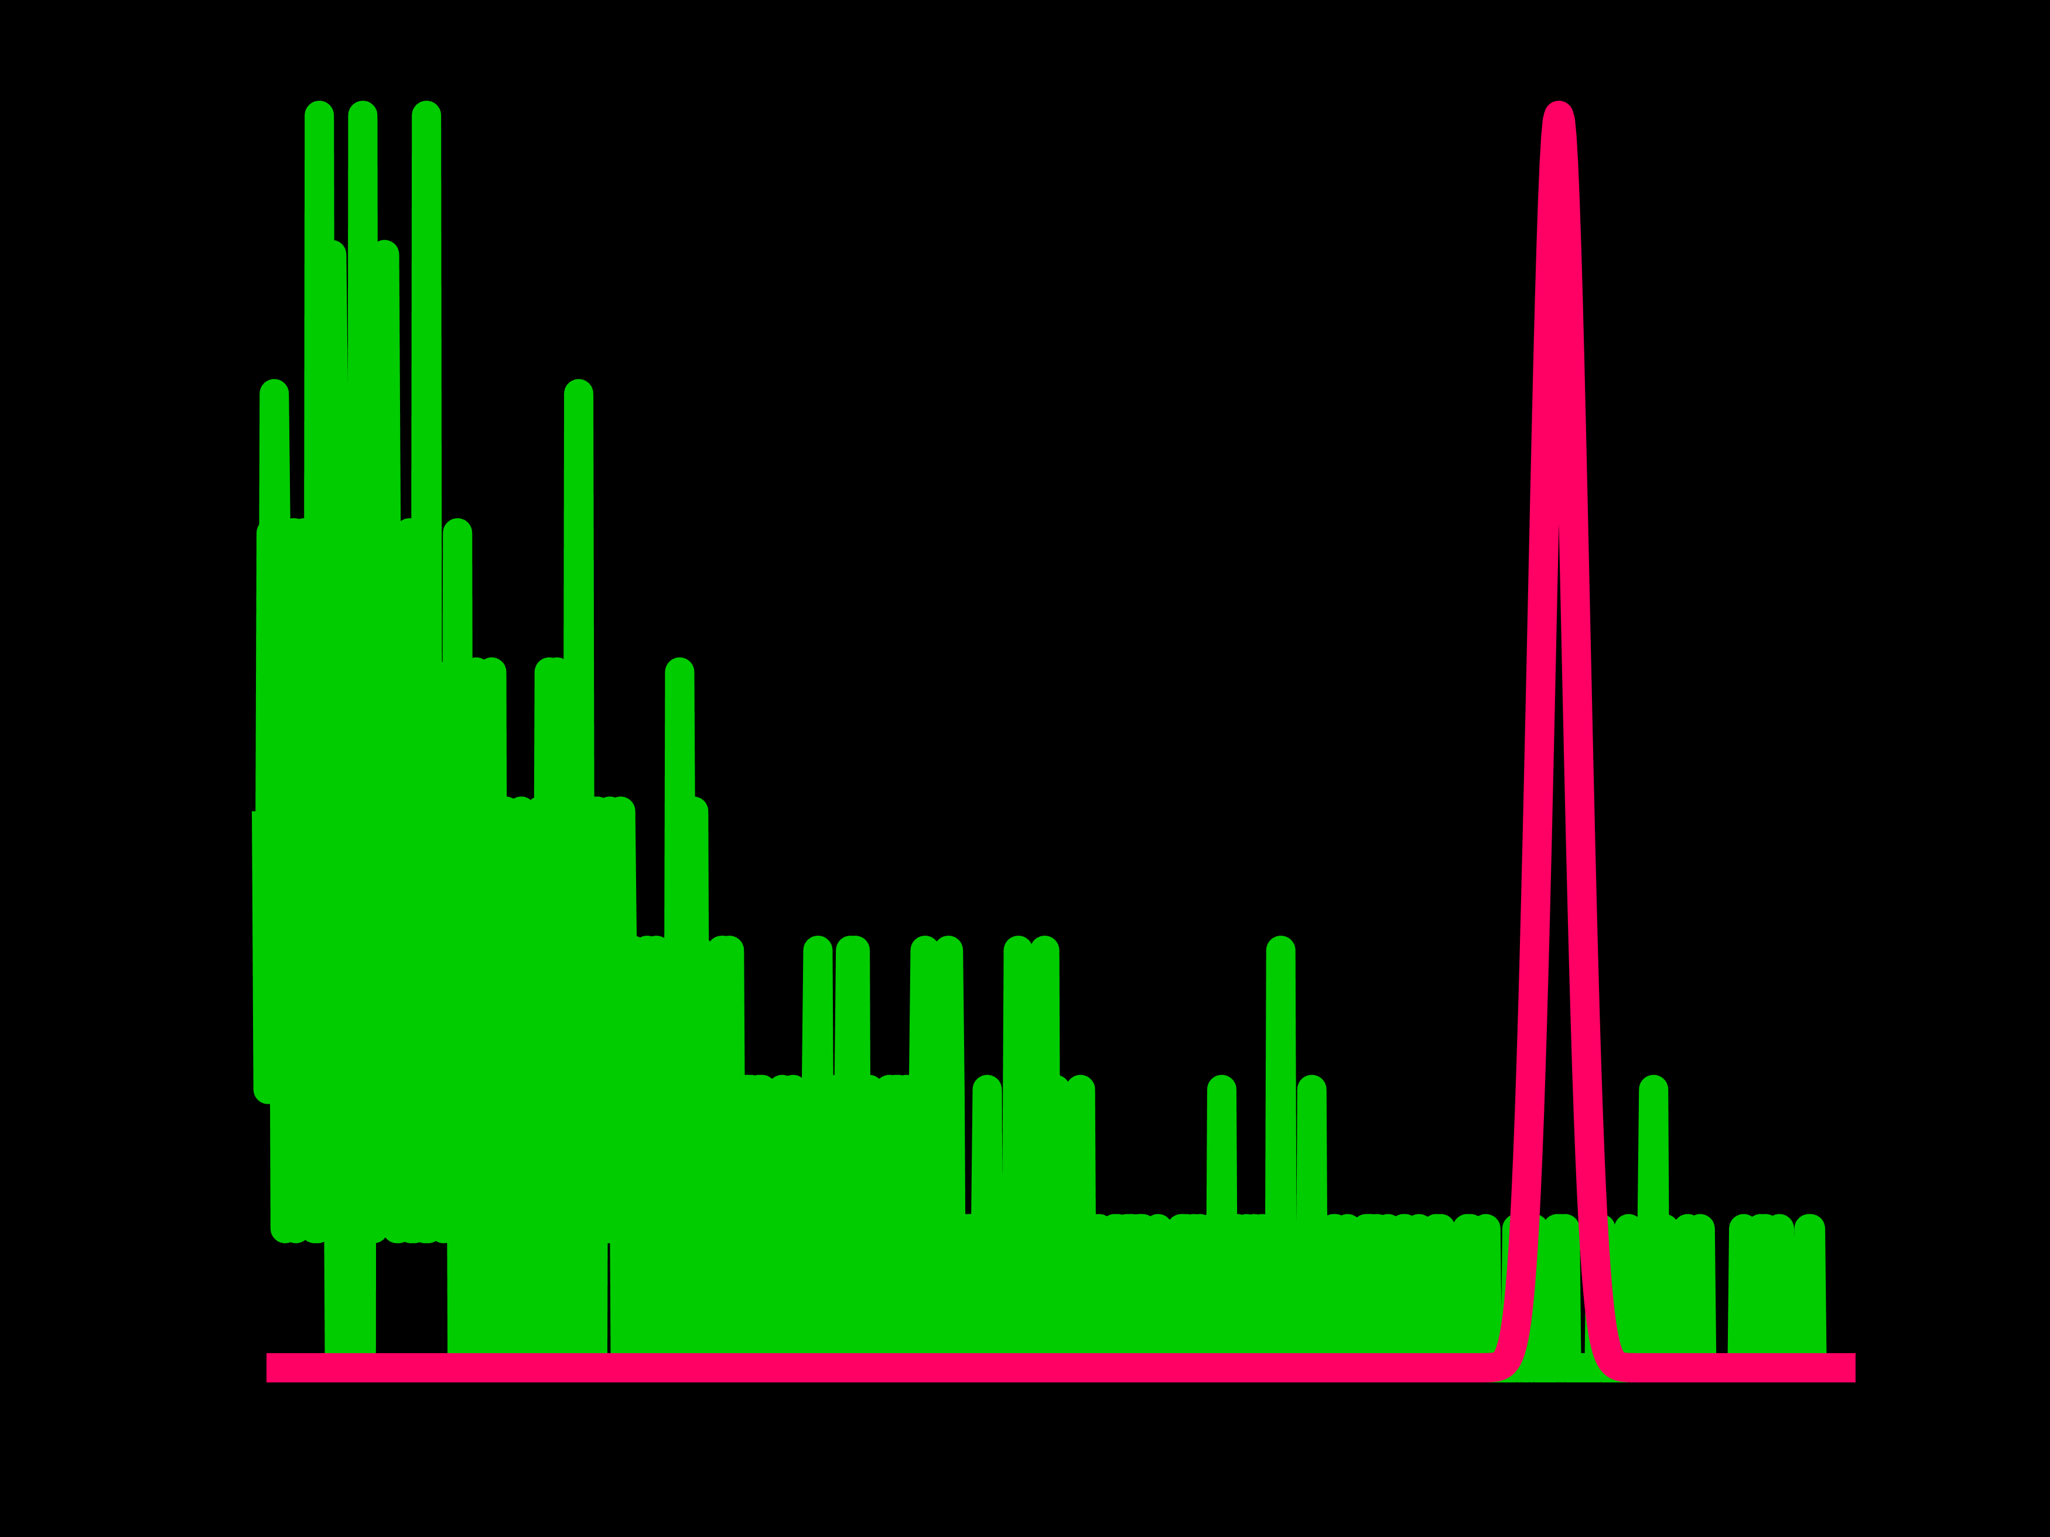
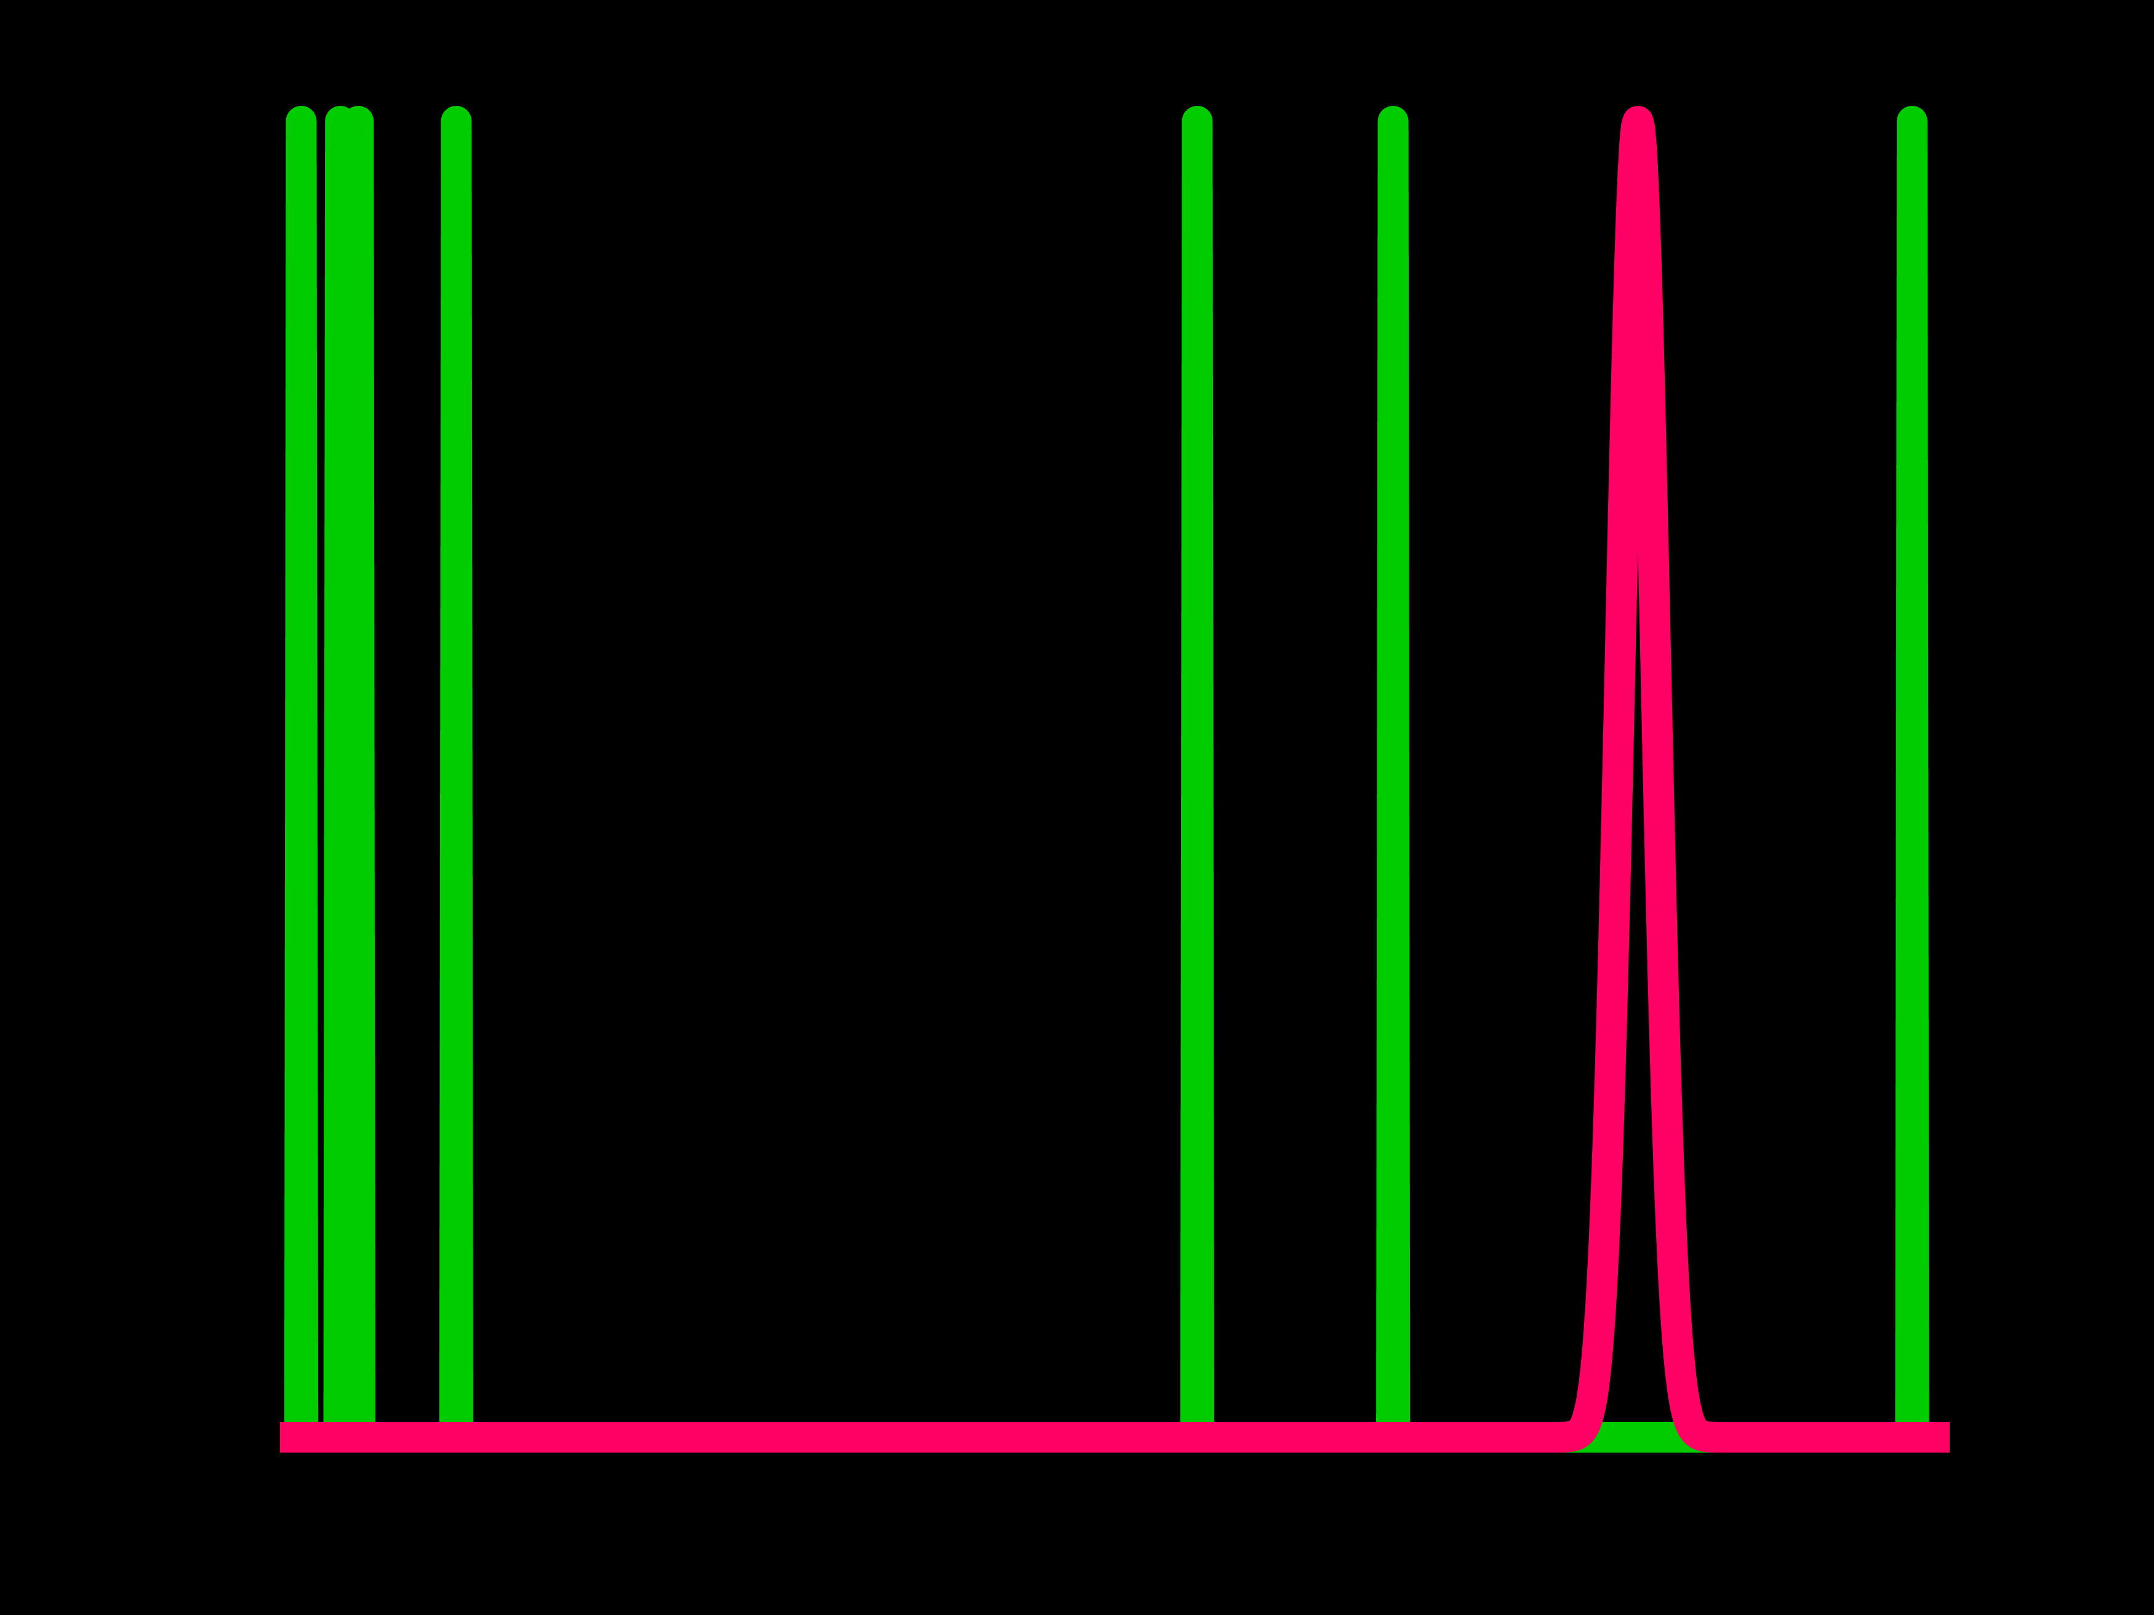
Problems
Too much photons
Too small photons
Intensity
Ground-truth
Intensity
Measured
Time
Time
Pileup distortion
Noise by low photon counts

Slide 28
Problems
Too much photons
How can we reduce distortions?
Intensity
Ground-truth
Measured
Time
Pileup distortion

Slide 29

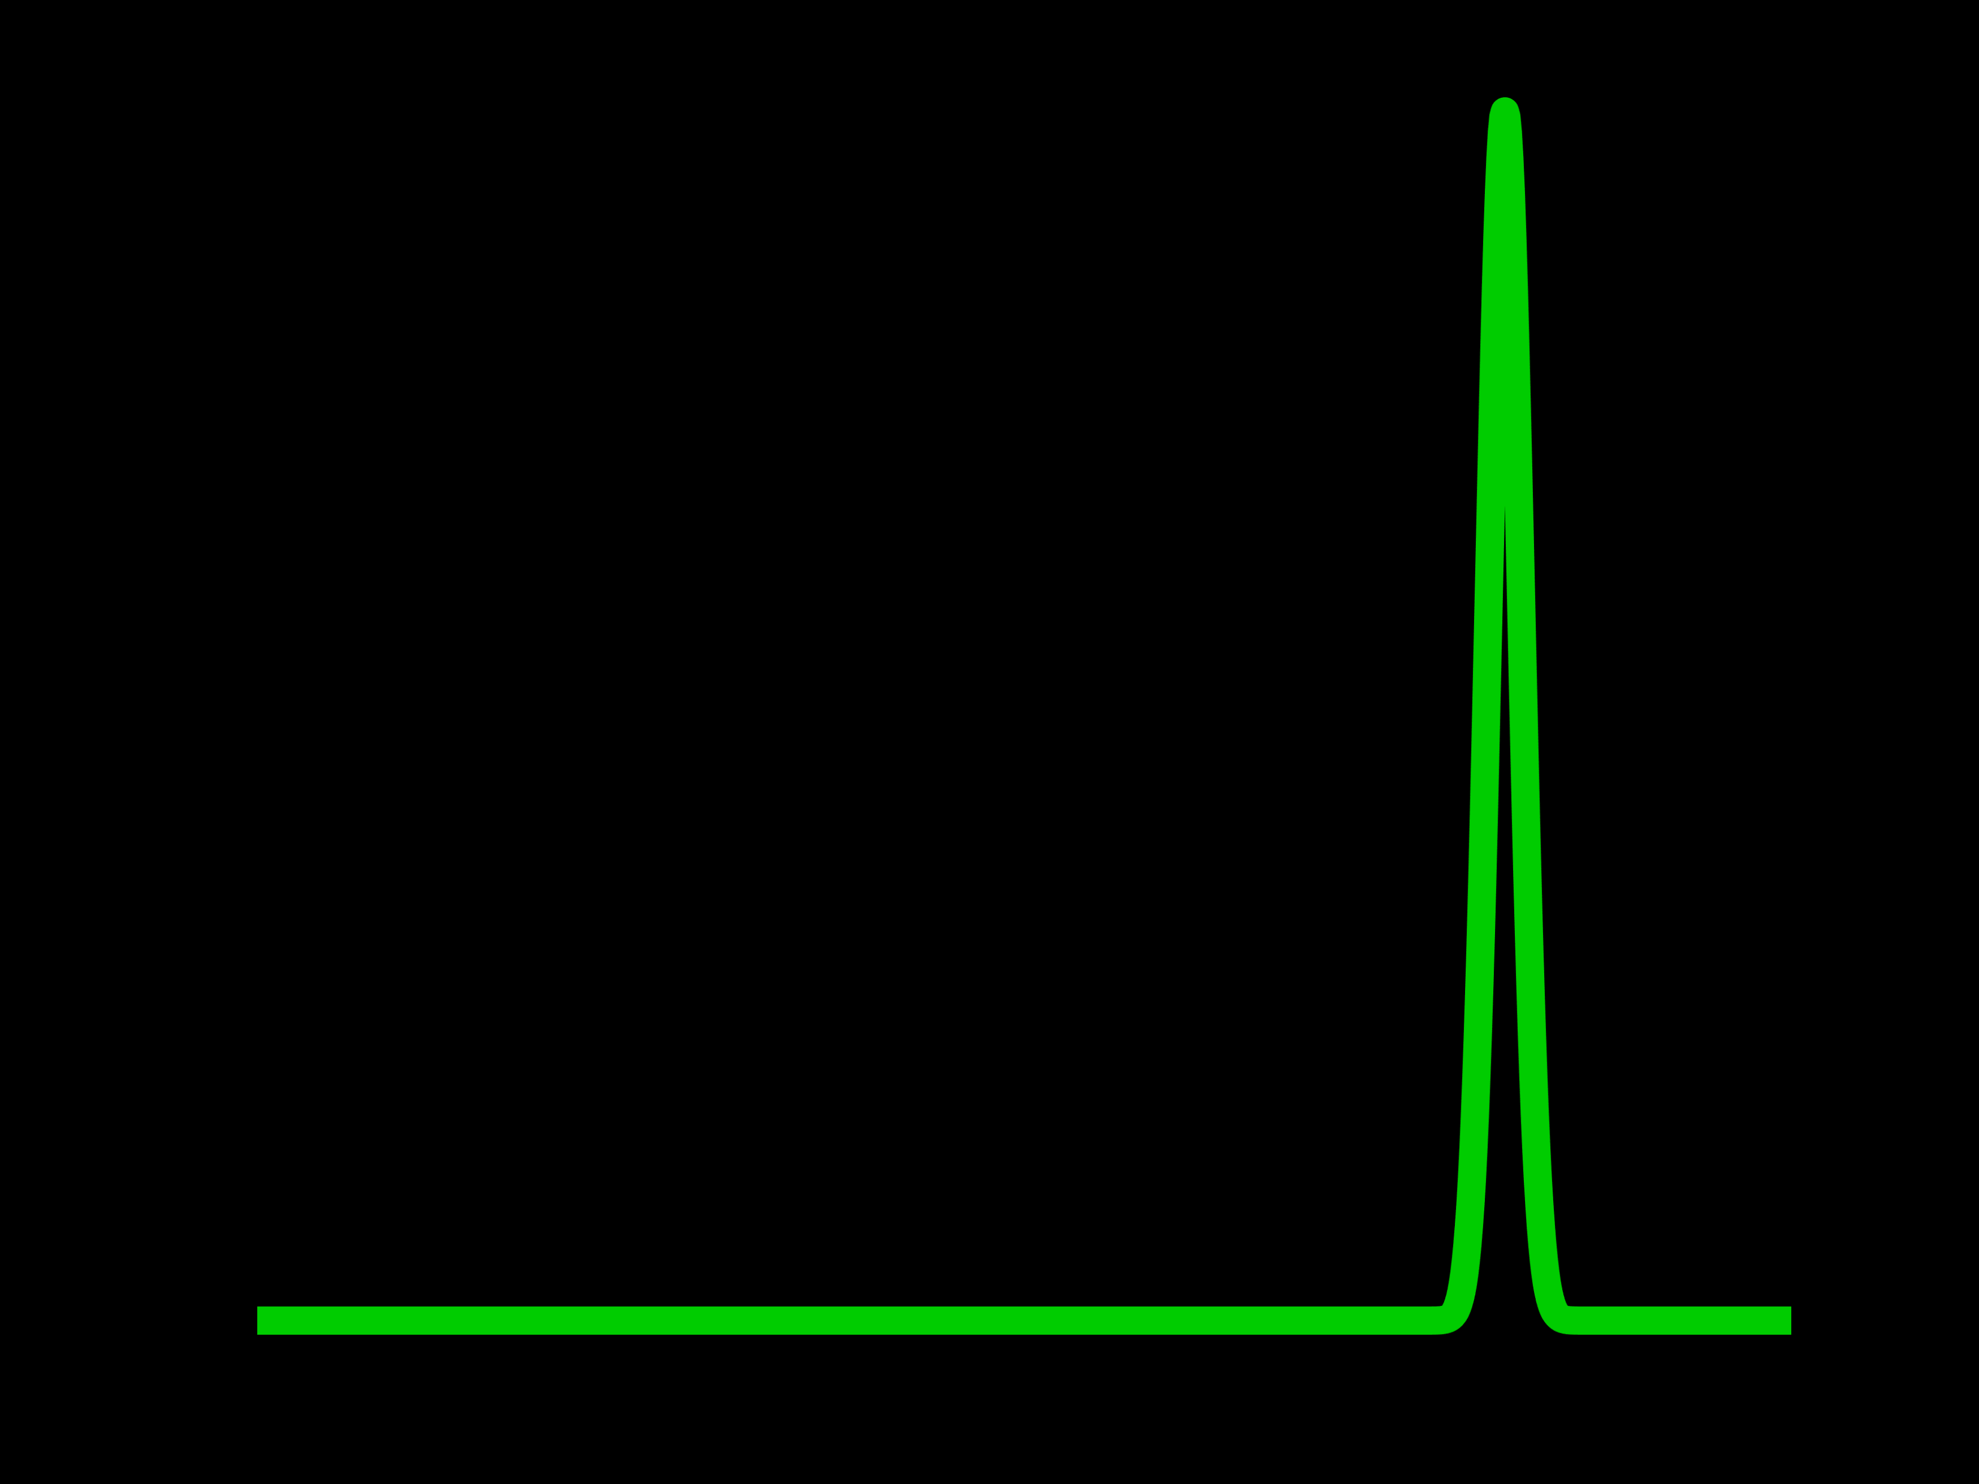


How to Reduce Distortions?
If we know the distortion model, we can revert it!
Photon detection probability
Incident photon flux
$$p=f\left(r\right)$$
$$r=f^{−1}\left(p\right)$$
Probability
Intensity
Time
Time

Slide 30
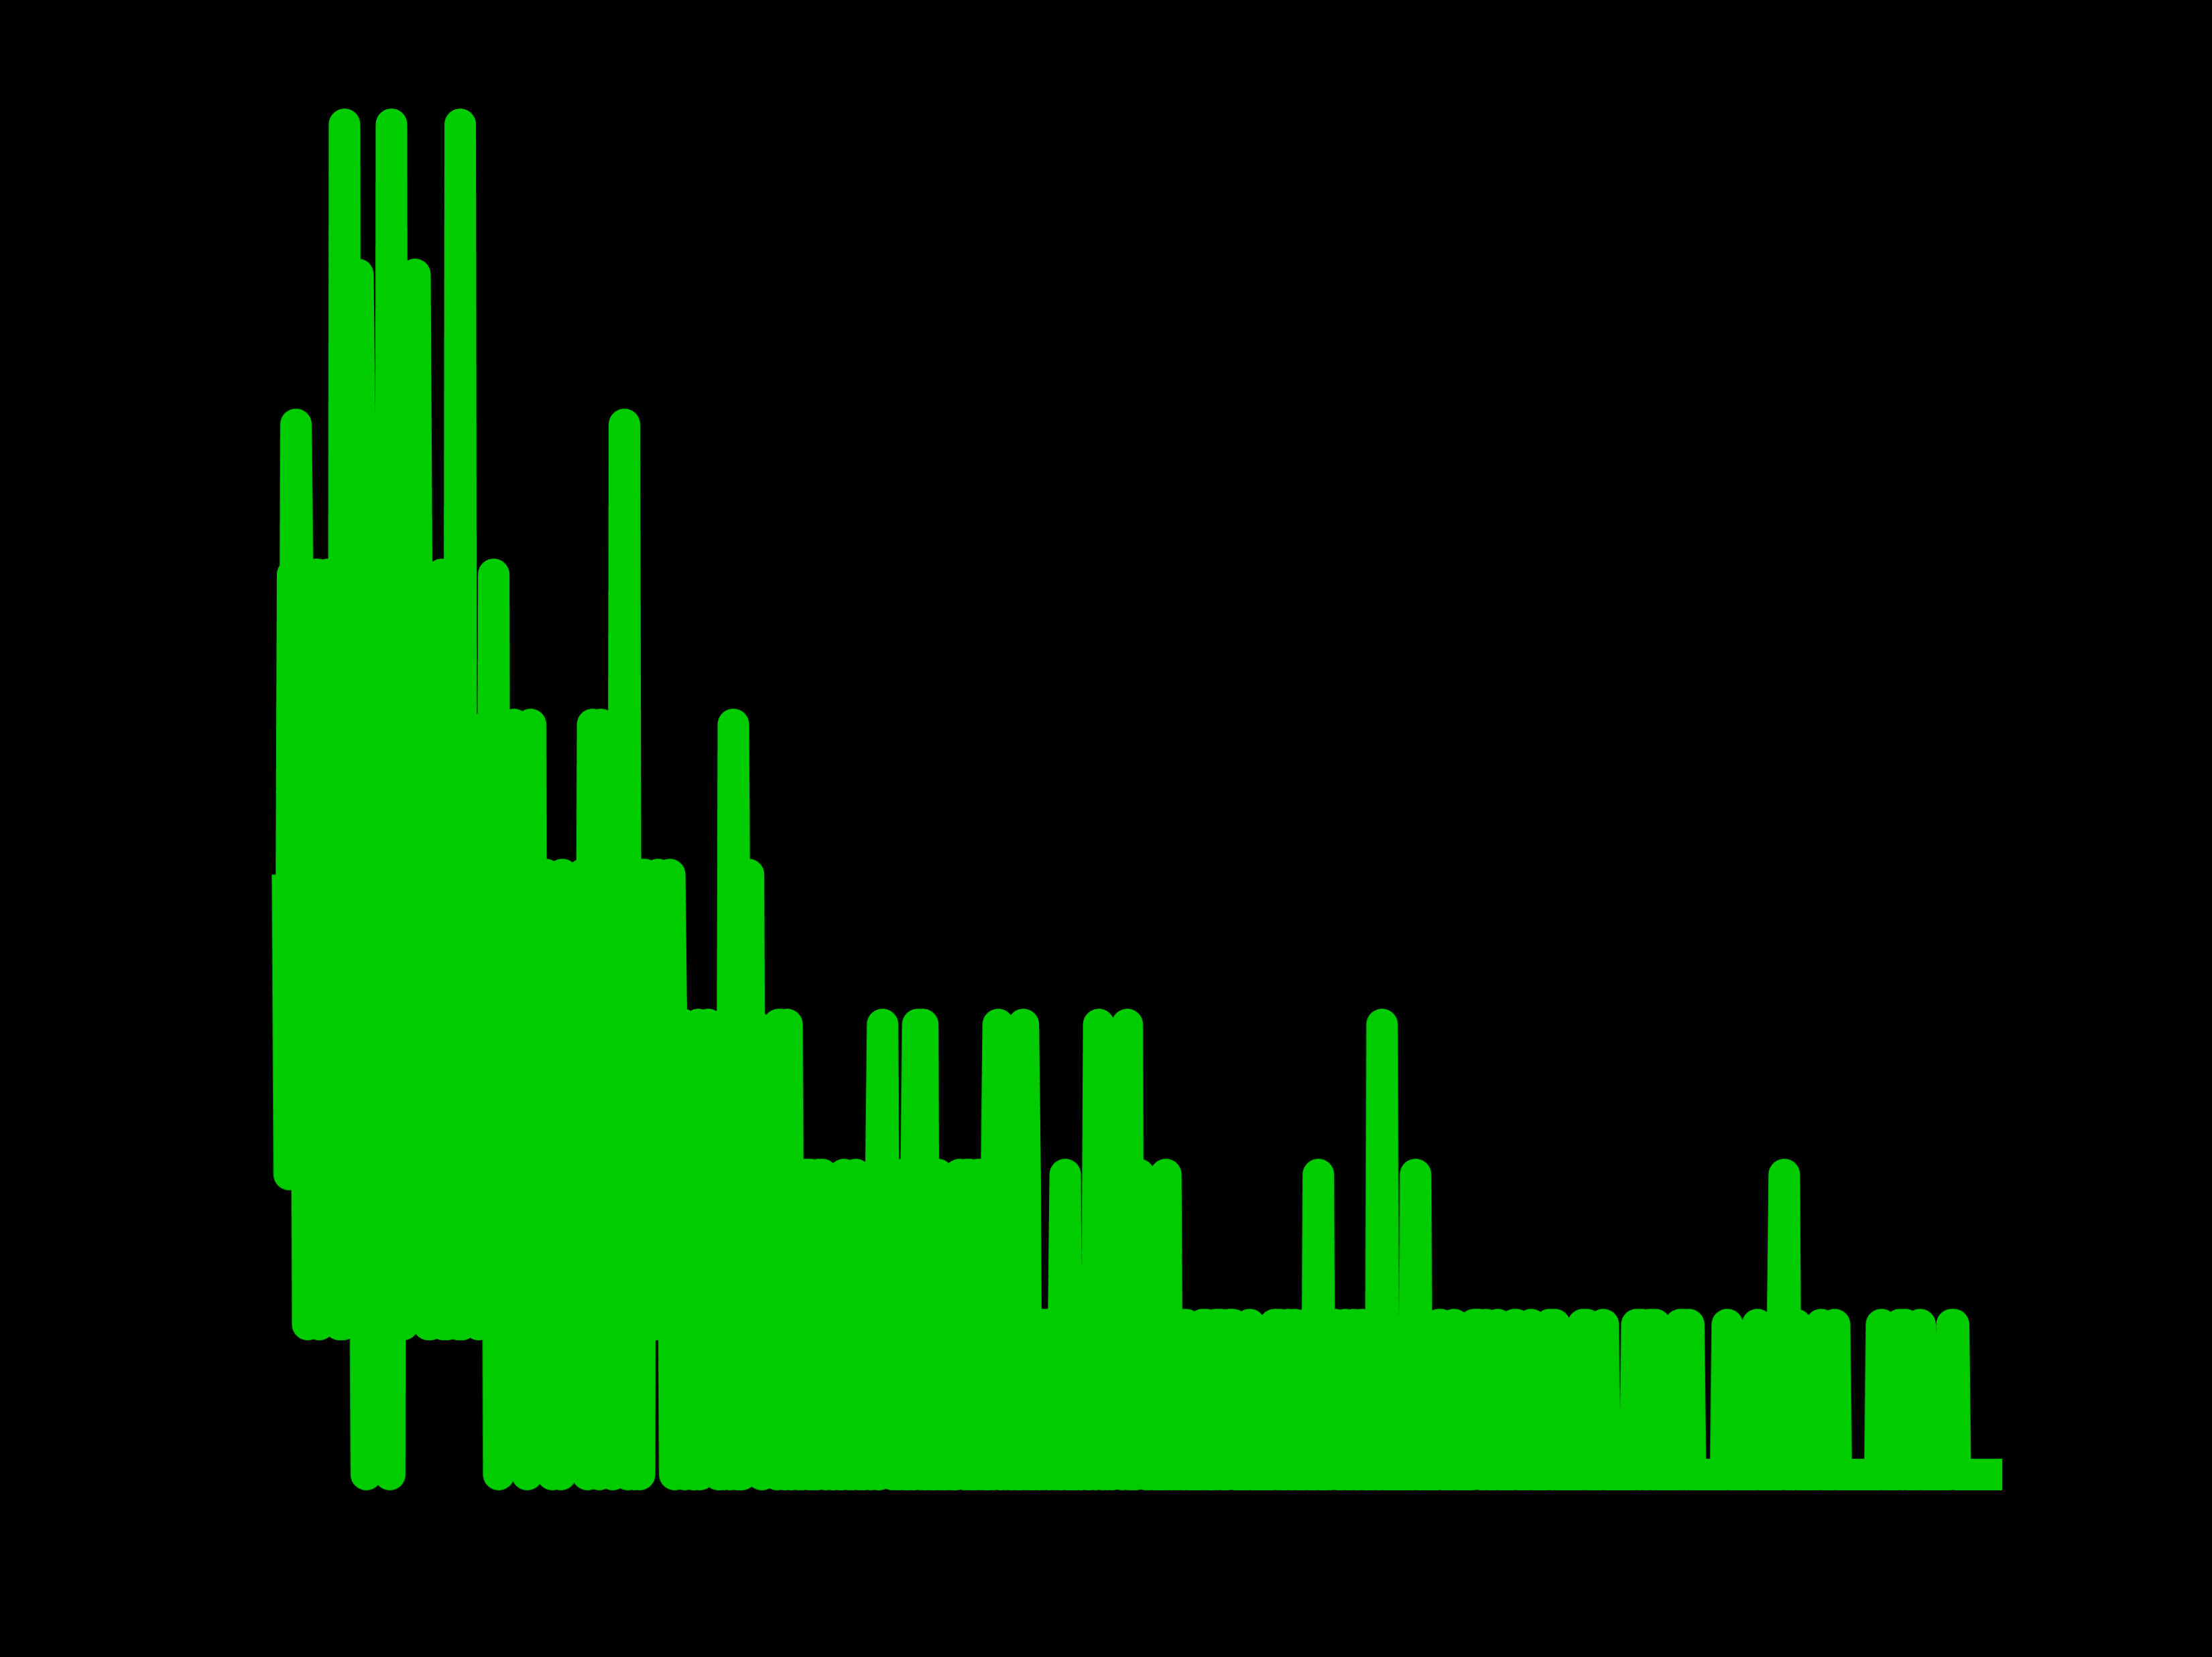
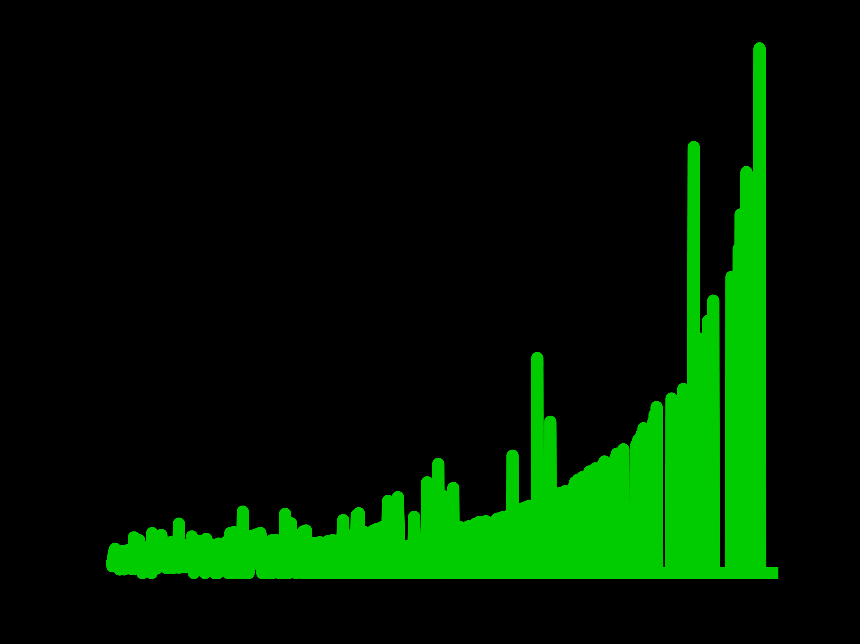
How to Reduce Distortions?
But noise is amplified in practice …
Photon detection probability
Incident photon flux
$$p=f\left(r\right)$$
$$r=f^{−1}\left(p\right)$$
Probability
Intensity
Time
Time

Slide 31
Problems
Pileup distortion
Noise by low photon counts
Intensity
Ground-truth
Intensity
Measured
Time
Time
Our original goal was to reduce distortions and noise

Slide 32
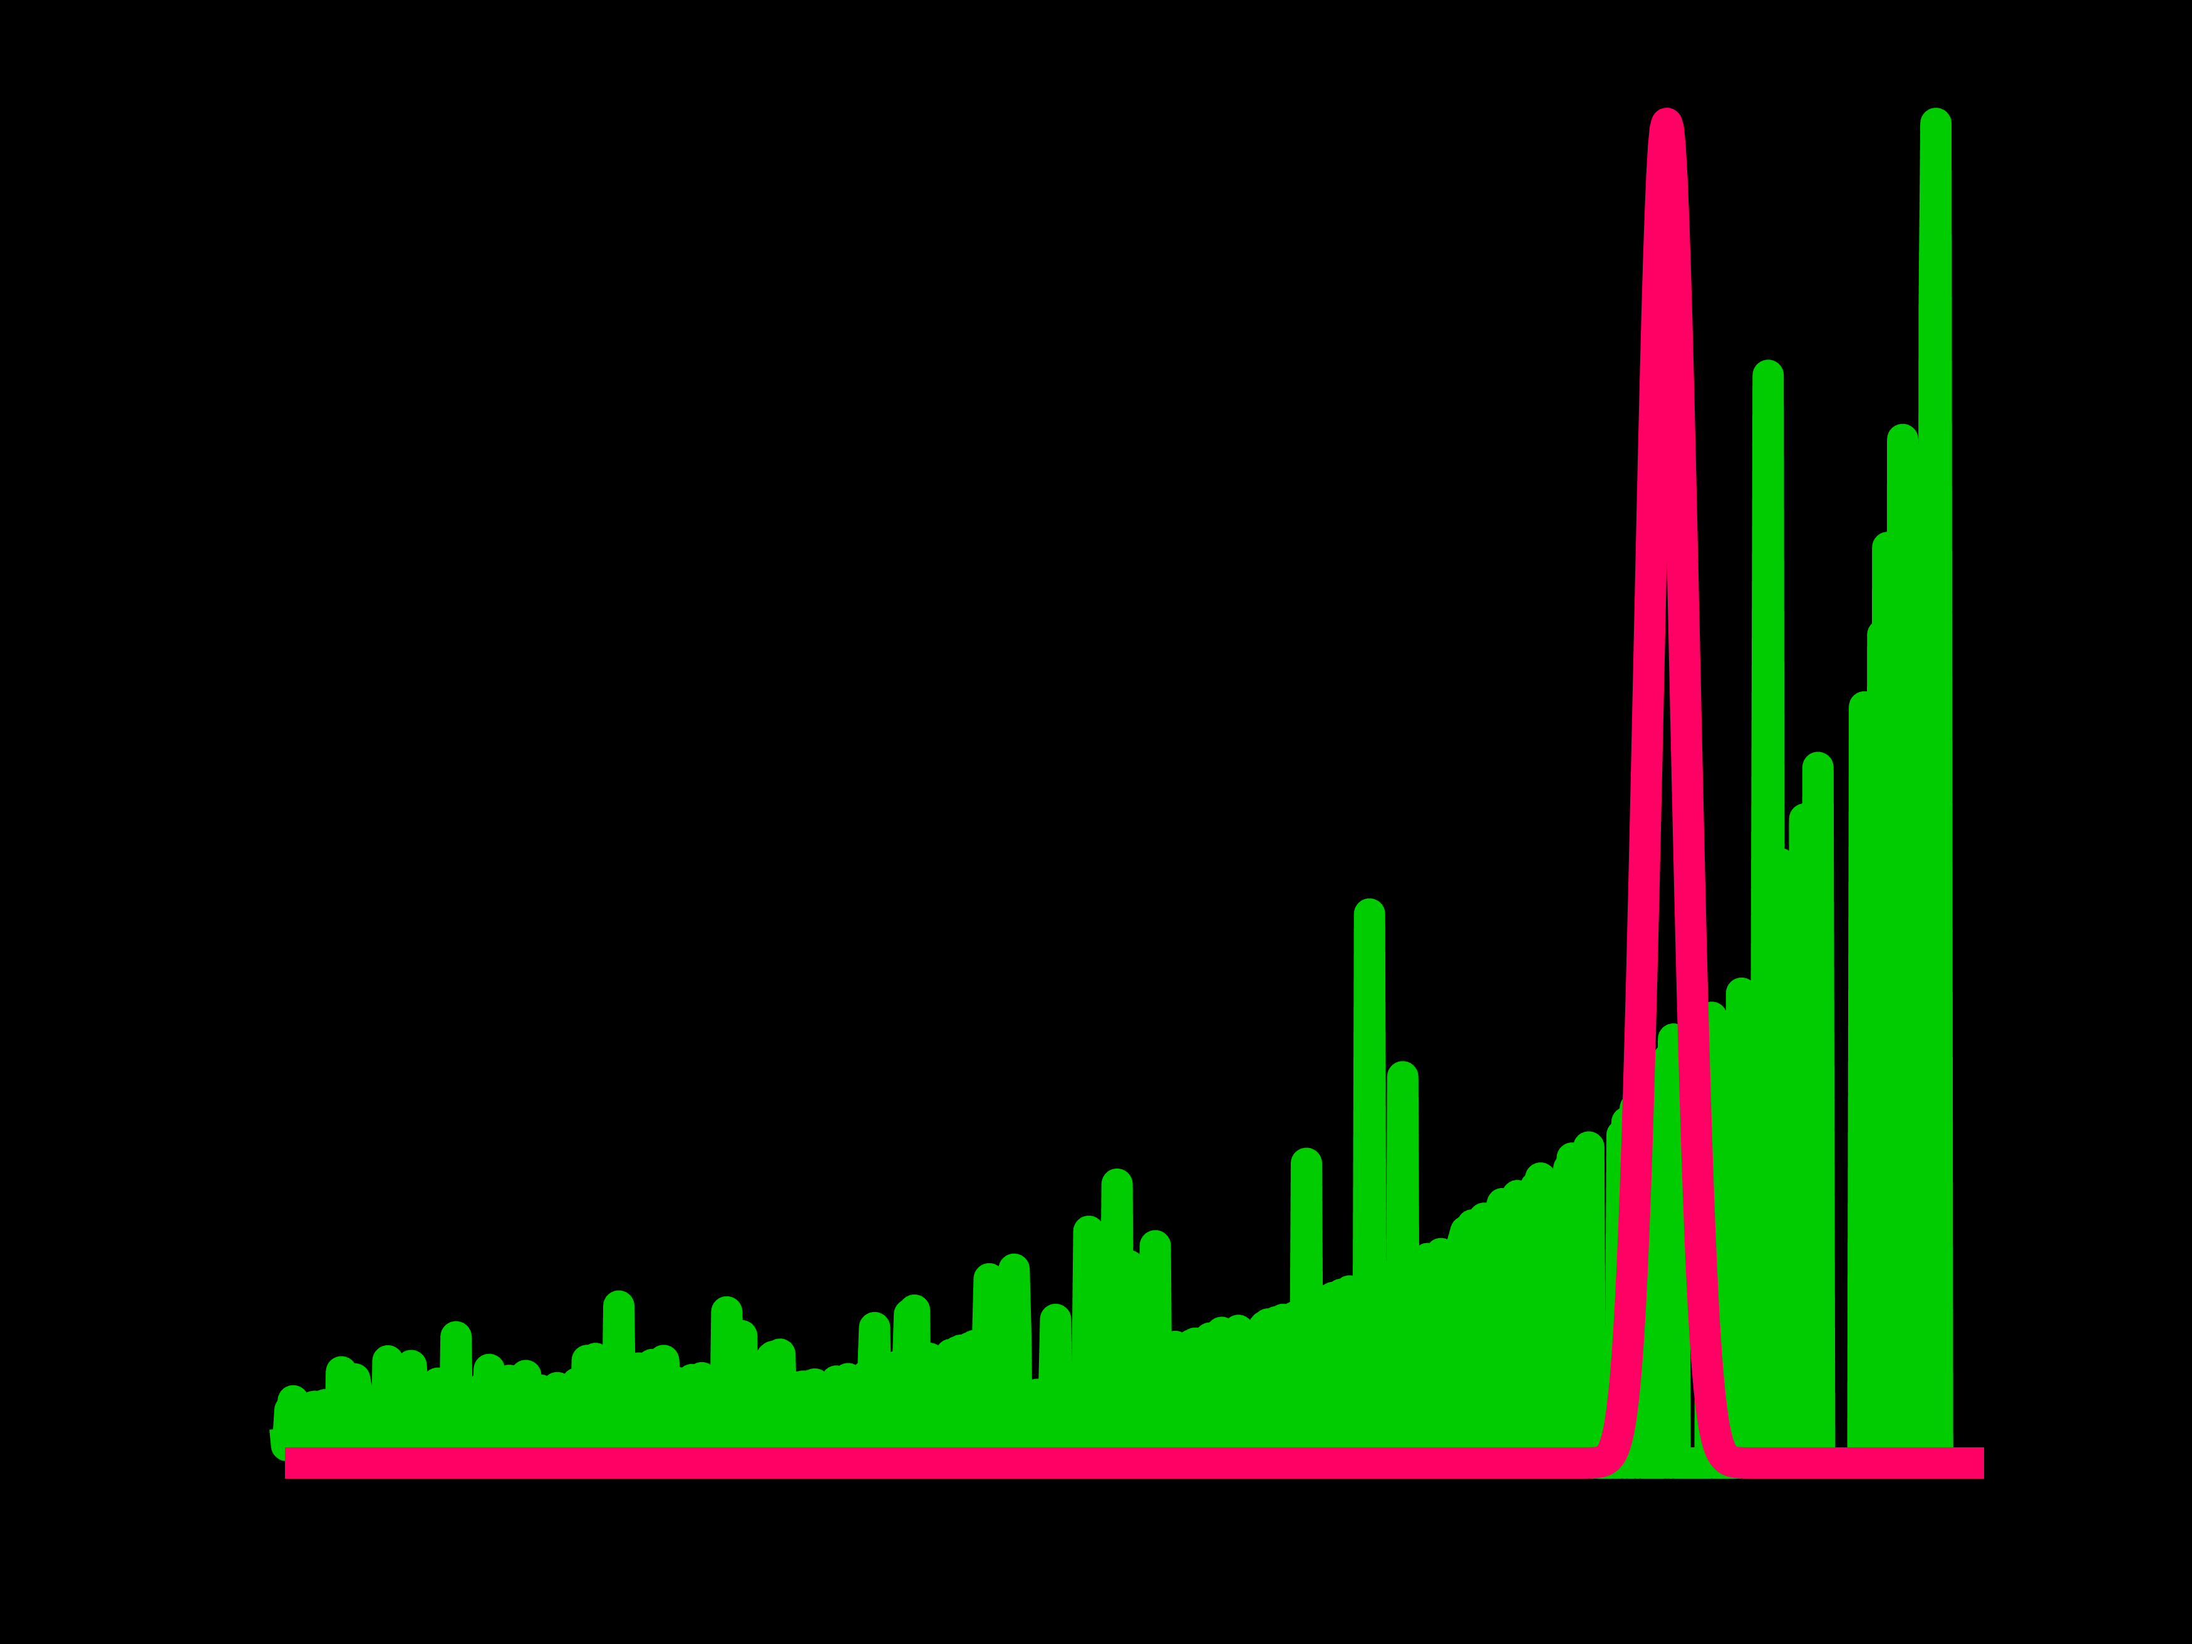
Problems
Noise by distortion correction
Noise by low photon counts
Intensity
Ground-truth
Intensity
Measured
Time
Time
Now our goal is just to reduce noise

Slide 33
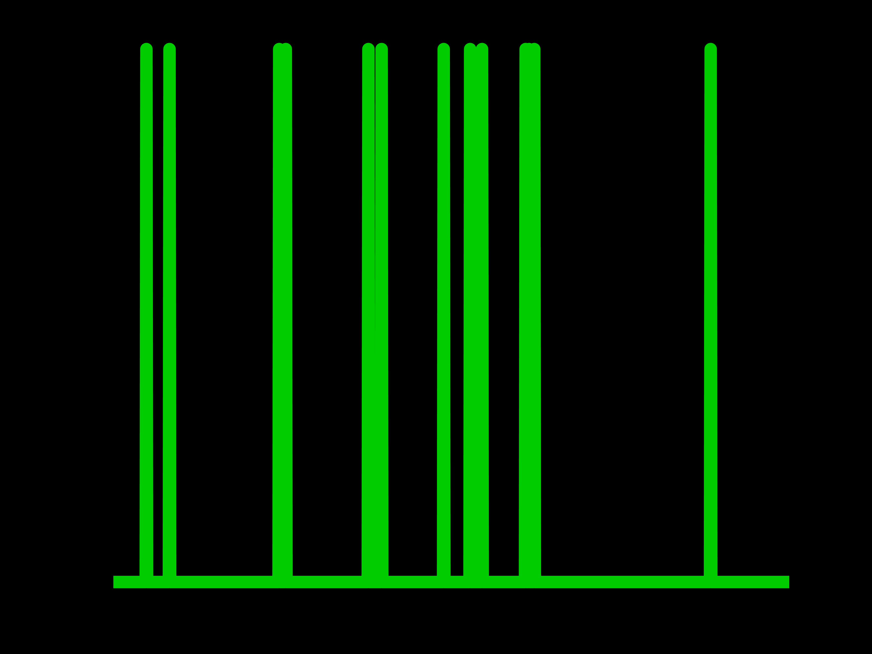

How to Reduce Noise?
Noisy
Recovered
Intensity
If we know SNR
Intensity
Time
Time
If we know signal & noise power ratio (or SNR), we can minimize error

Slide 34
How to Compute SNR?
Intensity
Mixed signal & noise
Original domain
Signal and noise are mixed in the original domain

Slide 35
How to Compute SNR?
Intensity
Magnitude
Signal
Mixed signal & noise
Noise
Original domain
Transform domain
Separate signal and noise in the transform domain

Slide 36



How to Compute SNR?
$$S$$
$$SNR= \frac{S}{N}$$
Intensity
Magnitude
Signal
Mixed signal & noise
Noise
$$N$$
Original domain
Transform domain
Compute signal and noise power ratio in the transform domain

Slide 37




Separate Signal & Noise: Photon Correlations
$$t$$
$$x$$
$$y$$
$$=$$
Intensity
Time
Similar
1D histogram
Temporal correlations

Slide 38
Separate Signal & Noise: Photon Correlations
$$t$$
$$x$$
$$y$$
Similar
3D cubelet
Temporal correlations
+ Spatial correlations

Slide 39
Separate Signal & Noise: Photon Correlations
$$t$$
$$x$$
$$y$$
Similar
4D cubelet set
Temporal correlations
+ Spatial correlations
+ Non-local correlations

Slide 40
Separate Signal & Noise: Photon Correlations
1D histogram
(Temporal correlation)
3D cubelet
(+ Spatial correlation)
4D cubelet set
(+ Non-local correlation)
FFT
FFT
FFT
Magnitude
Magnitude
Magnitude
Frequency
Frequency
Frequency
Measurement
Ground-truth signal
Better signal-noise separation when more correlations available

Slide 41
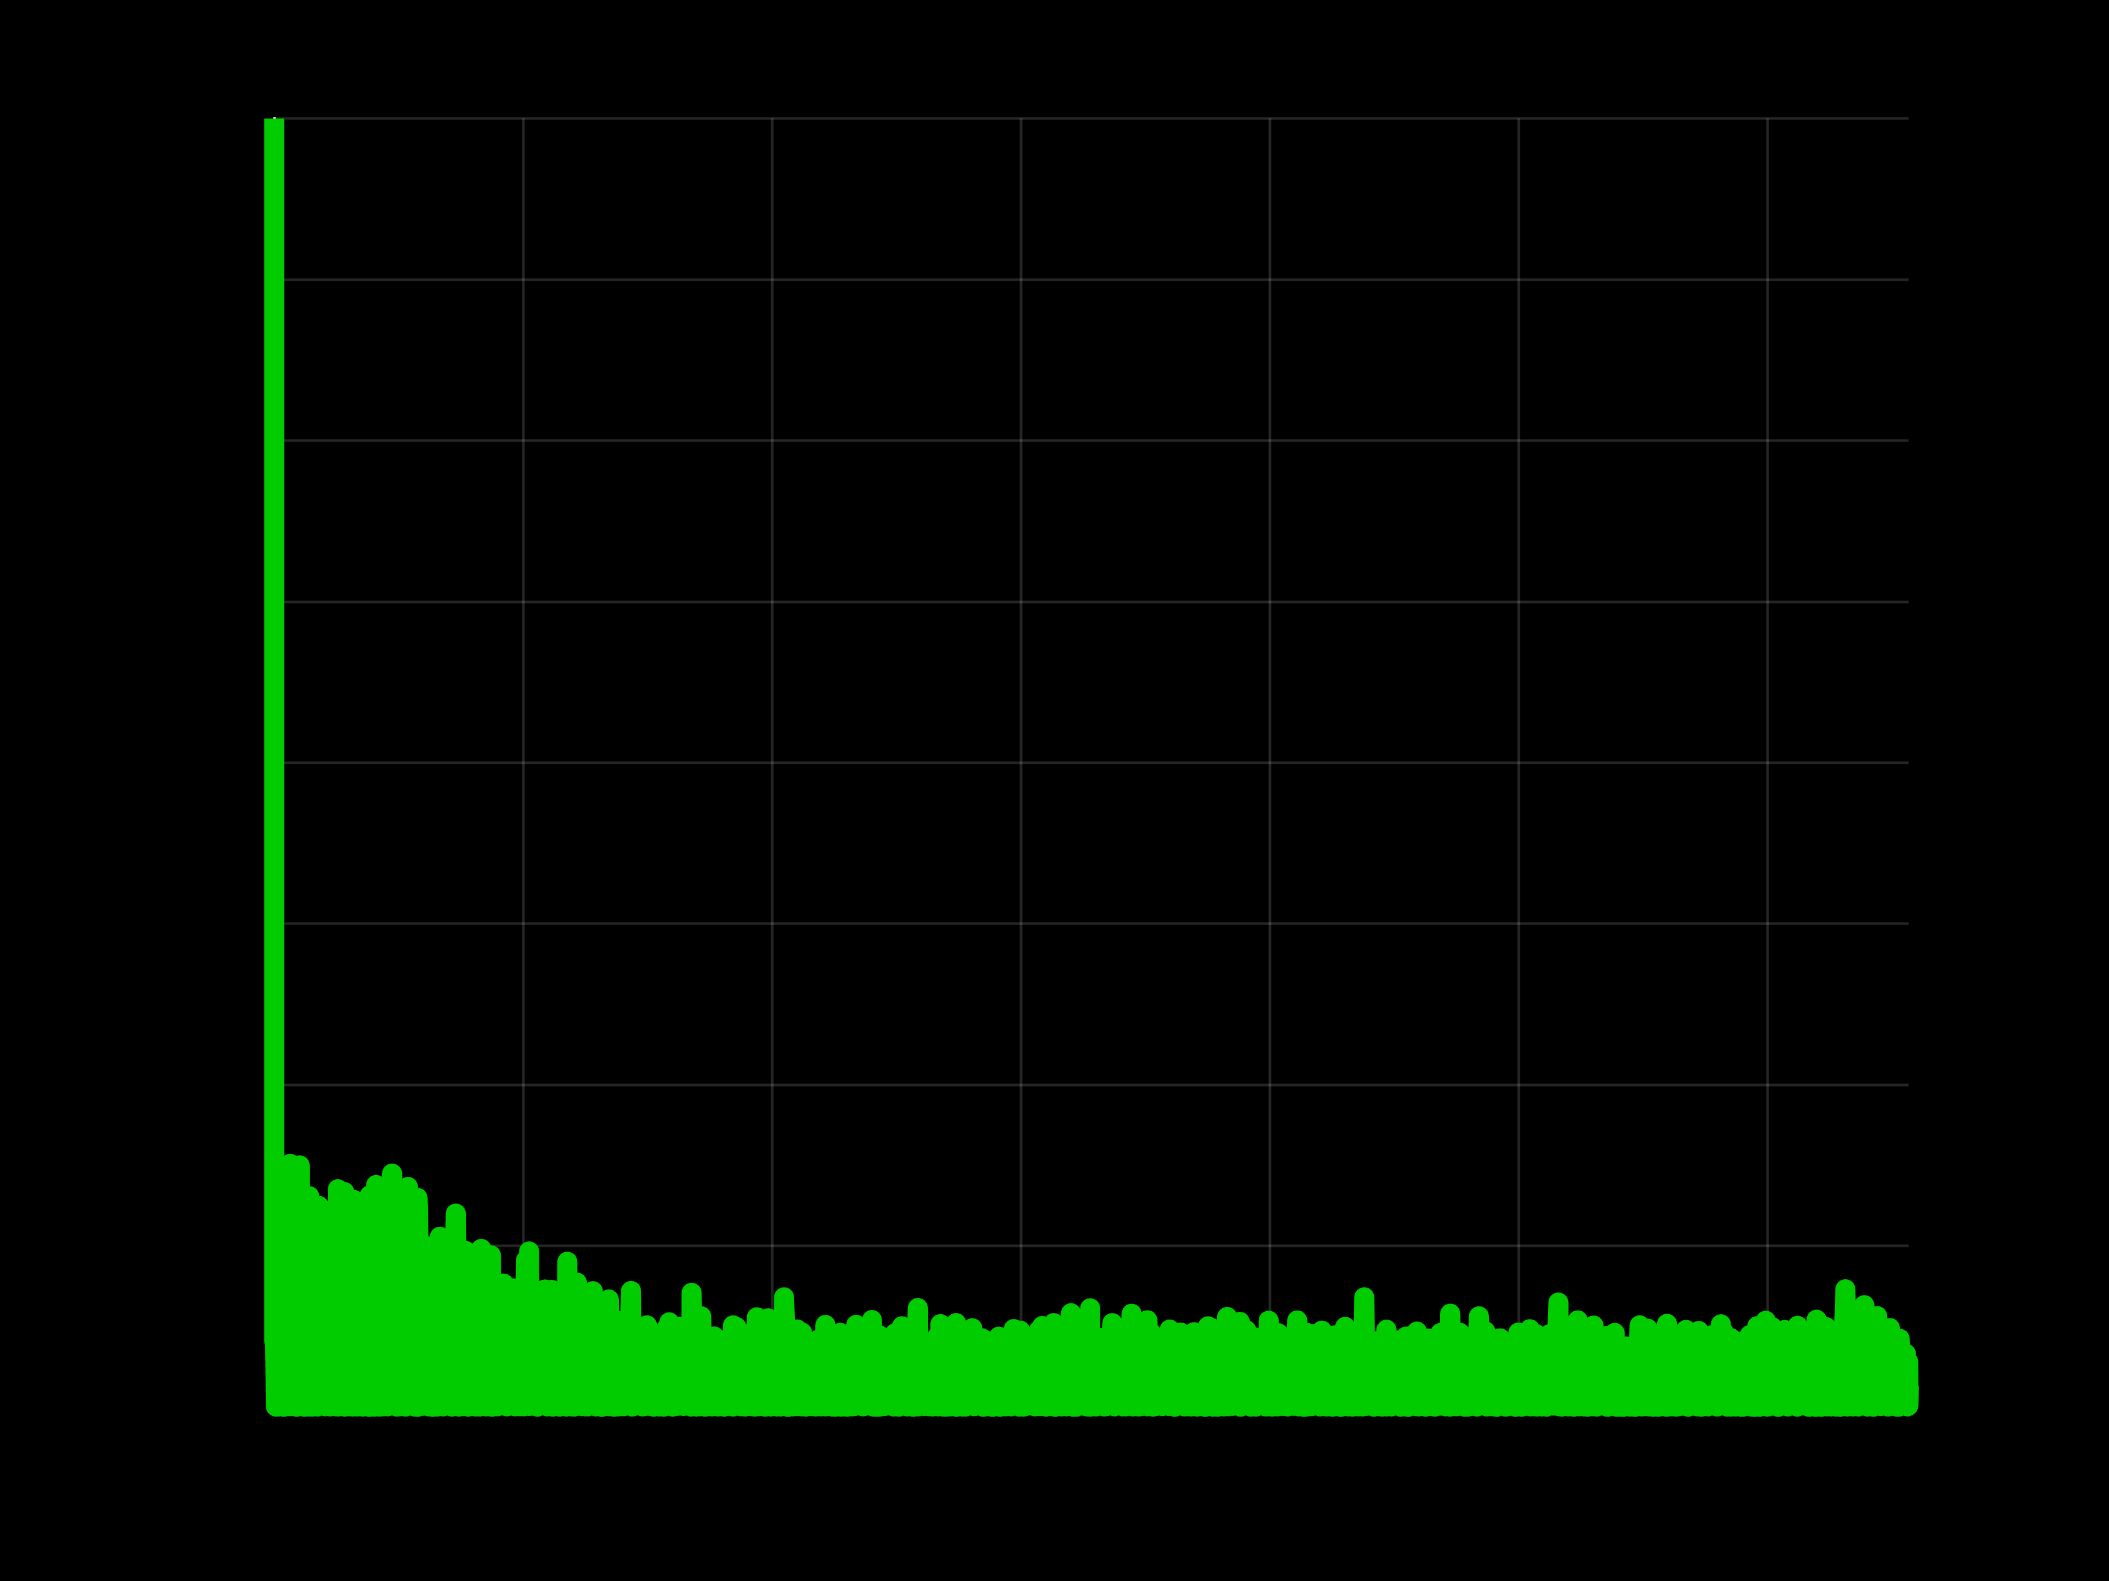
Signal & Noise Estimation
Magnitude
Frequency
Measurement
Ground-truth signal
So, how much signal & noise are here?

Slide 42
Noise Estimation: Laser Prior
Light source
Intensity
Time
Scene
LiDAR
Intensity
Single-photon sensor
Time

Slide 43
Noise Estimation: Laser Prior
Light source
Intensity
Time
Scene
LiDAR
Low-pass filter
Intensity
Single-photon sensor
Time
Noise-free fluxes cannot have higher frequencies than the laser pulse

Slide 44
Noise Estimation: Laser Prior
Light source
Intensity
Time
Scene
Imaging through scattering
LiDAR
FLIM
Low-pass filter
Intensity
Single-photon sensor
Time
Time
Time
This is also true for other applications

Slide 45
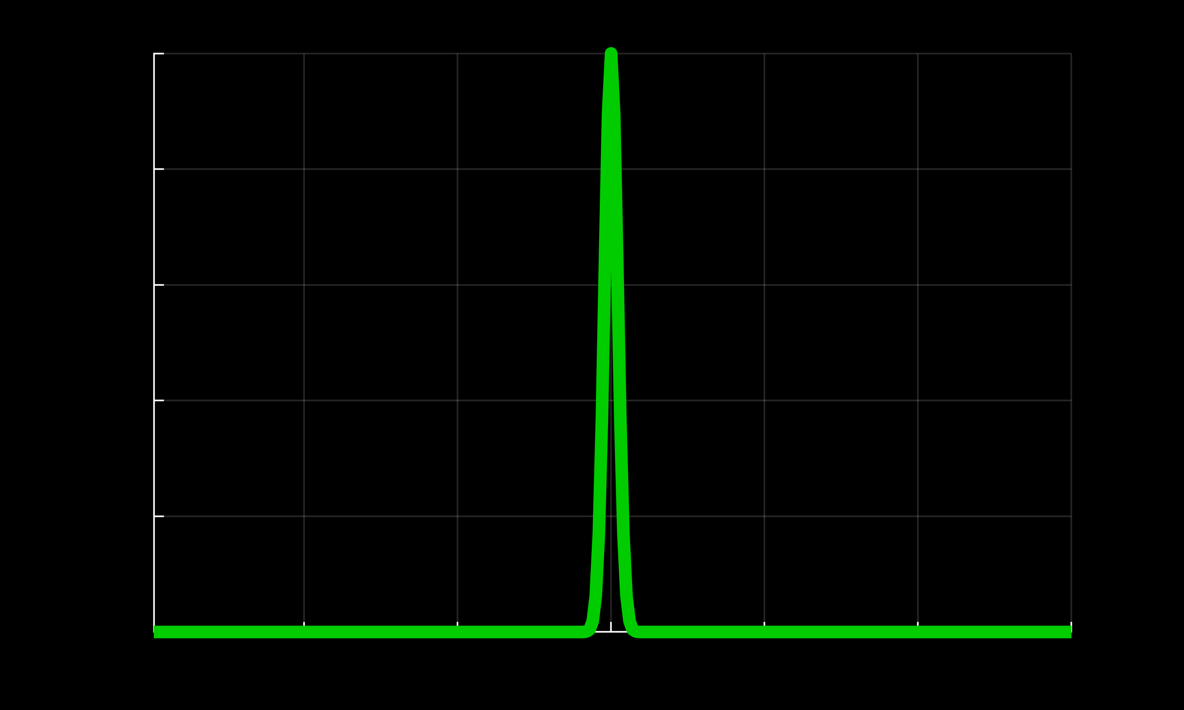
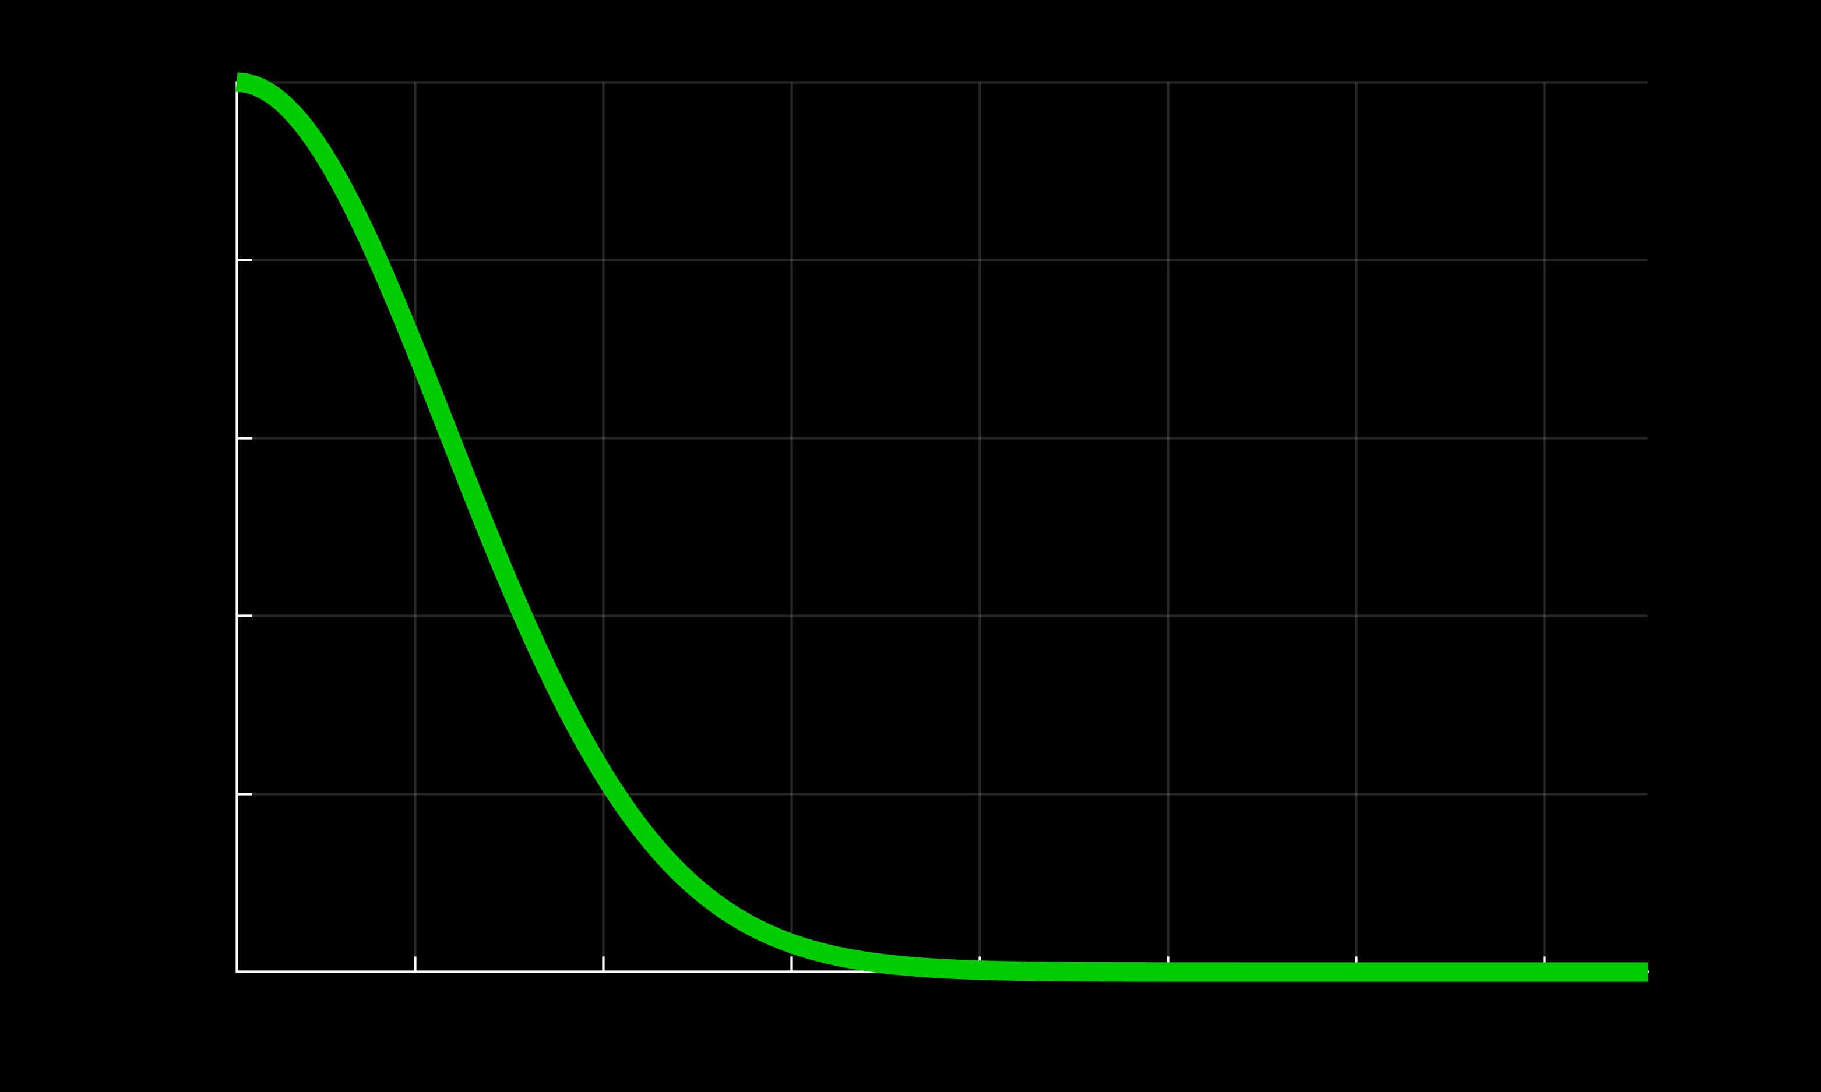
Noise Estimation: Pure Noise Band
Time domain
Frequency domain
Gaussian pulse:
Intensity
Magnitude
Time
Frequency

Slide 46
Noise Estimation: Pure Noise Band
Time domain
Frequency domain
Gaussian pulse:
Intensity
Magnitude
Pure noise band
Time
Frequency
Pure noise band is defined from Fourier response of laser pulse

Slide 47
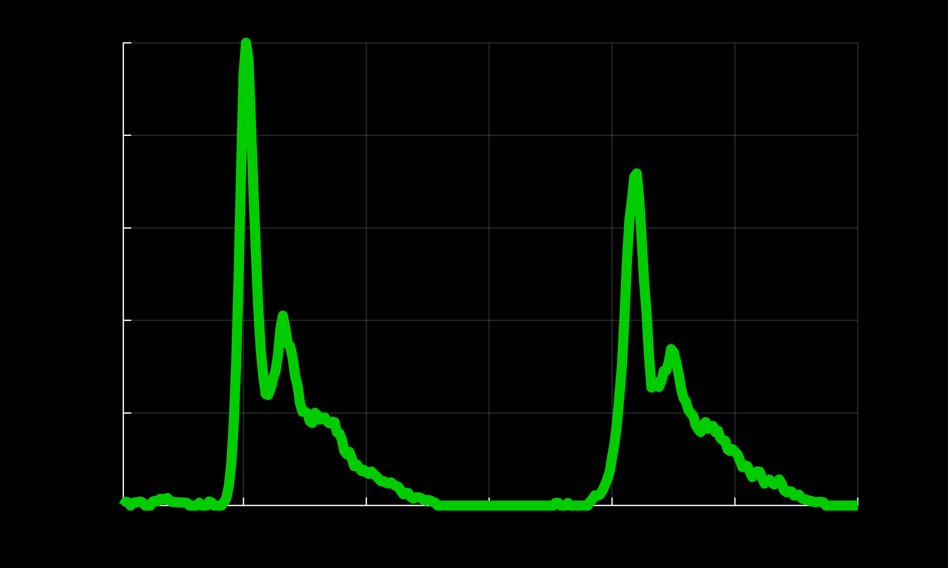
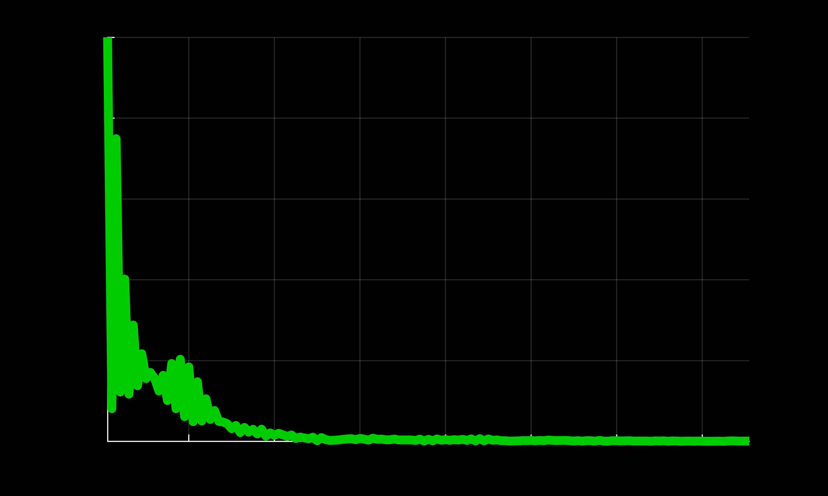
Noise Estimation: Pure Noise Band
Time domain
Frequency domain
Gaussian pulse:
Intensity
Magnitude
Pure noise band
Time
Frequency
Real system pulse:
Intensity
Magnitude
Pure noise band
Time
Frequency
Pure noise band is defined from Fourier response of laser pulse

Slide 48
Noise Estimation
Magnitude
Measured
Frequency
So, how much noise is here?

Slide 49
Noise Estimation
Pure noise band
Magnitude
Laser pulse
Measured
Frequency
Pure noise band is isolated by laser frequency profile

Slide 50
Noise Estimation
Pure noise band
Magnitude
Laser pulse
Measured
Noise threshold
Frequency
Noise power is computed from the pure noise band

Slide 51
Pilot Signal Estimation
Pure noise band
Magnitude
Laser pulse
Measured
Noise threshold
Frequency
Noise threshold is defined from pure noise band

Slide 52
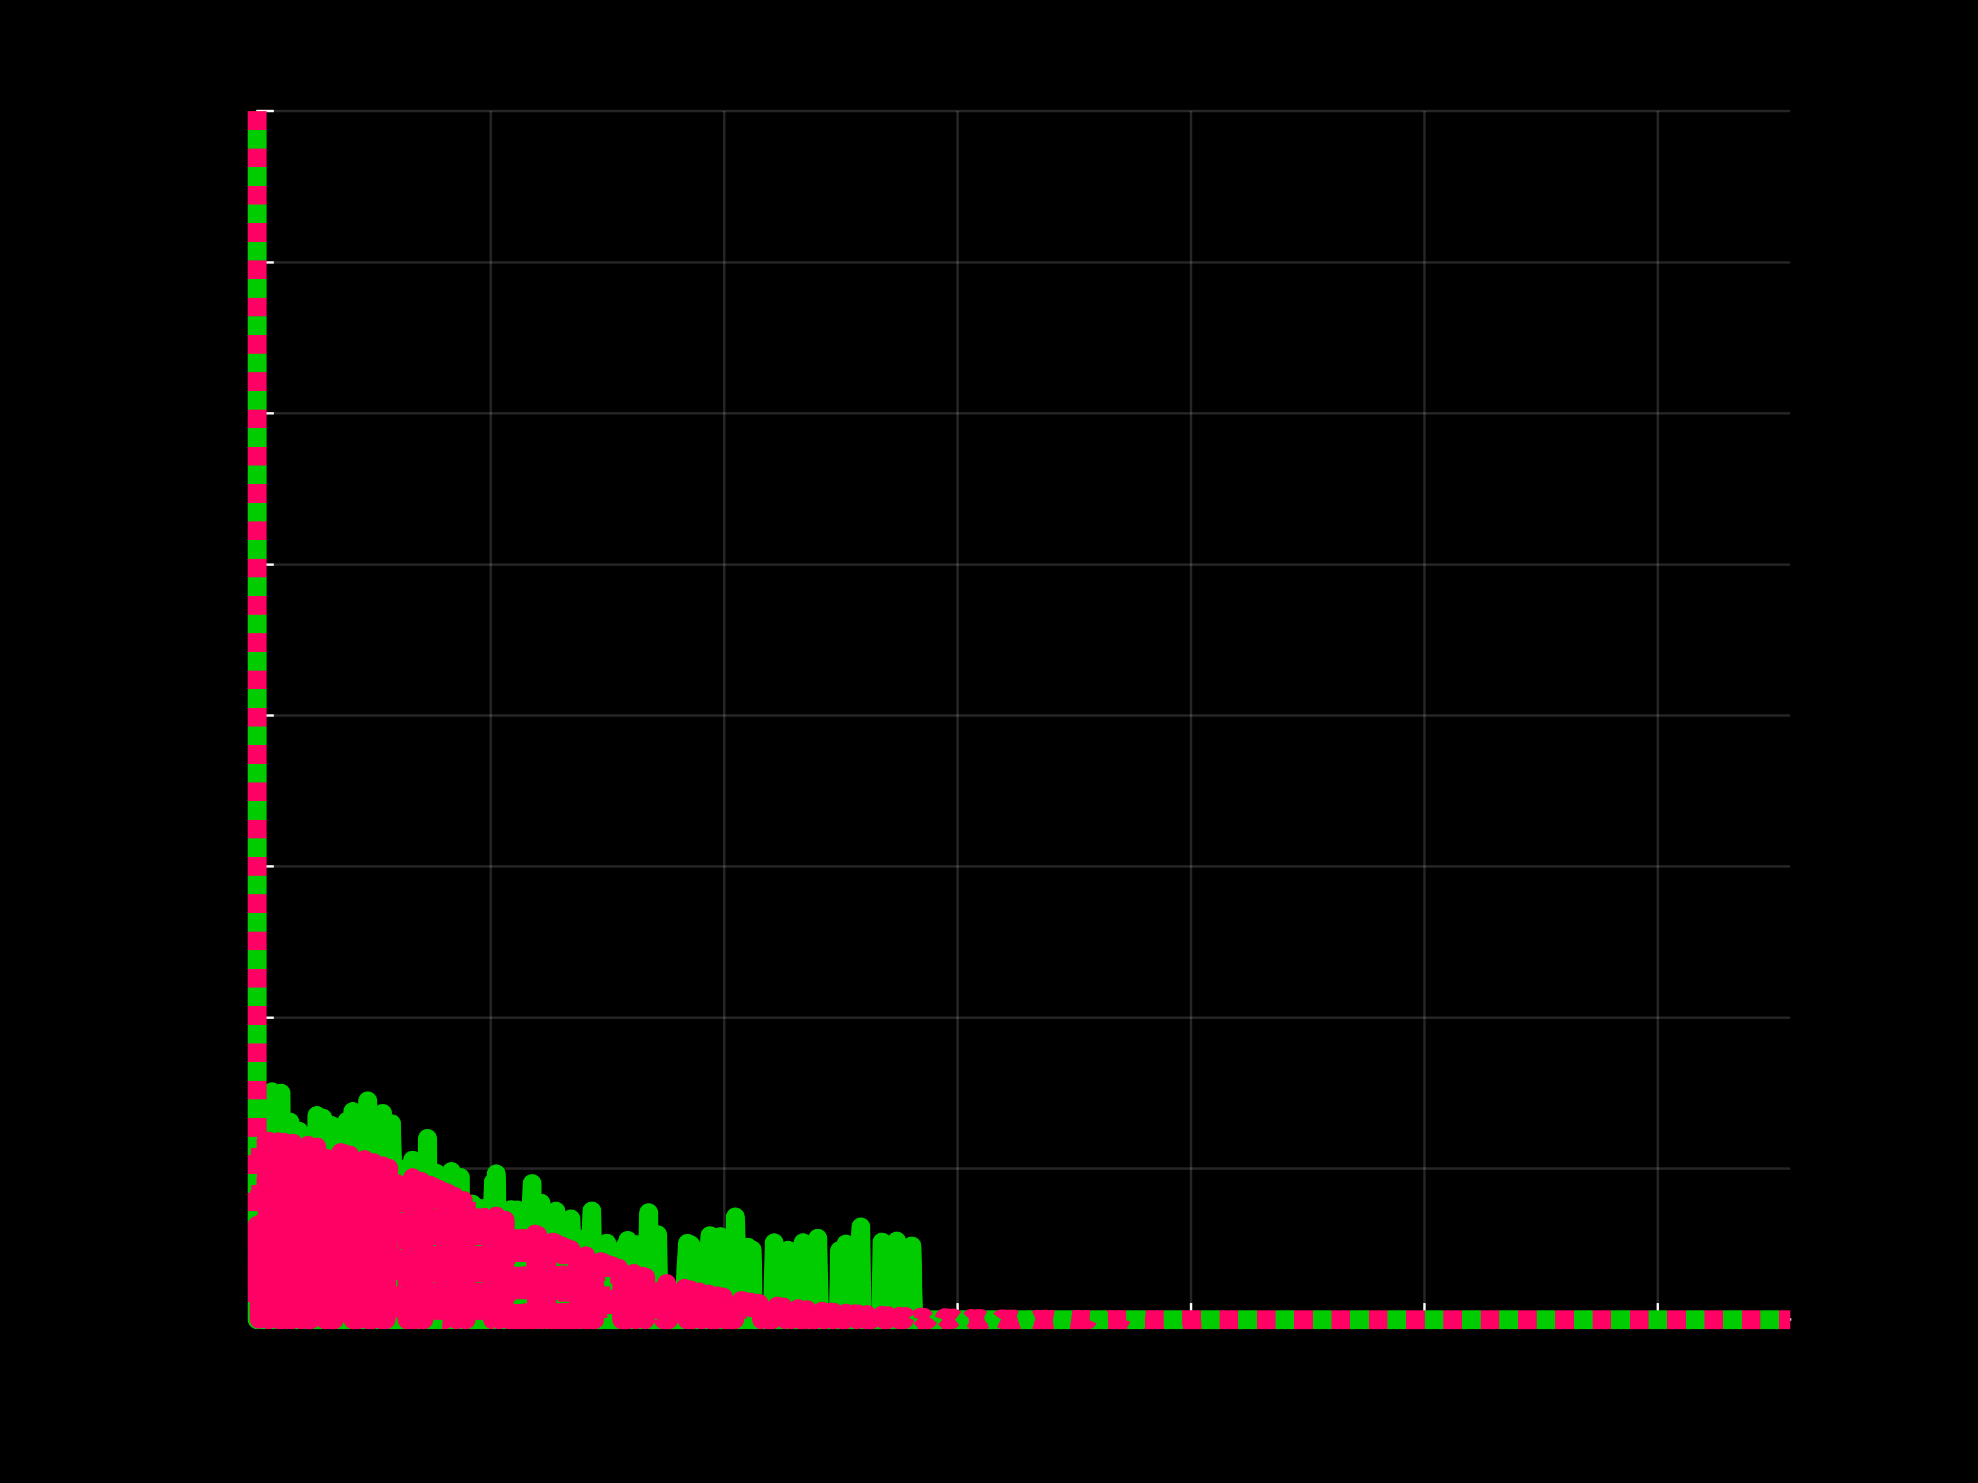
Pilot Signal Estimation
Pure noise band
Magnitude
Ground-truth
Measured
Noise threshold
Frequency
Simple thresholding with noise boundary

Slide 53
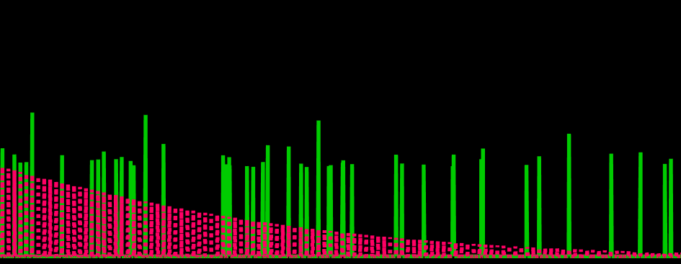
Pilot Signal Estimation
Magnitude
Ground-truth
Measured
Noise threshold
Frequency
Simple thresholding with noise boundary

Slide 54
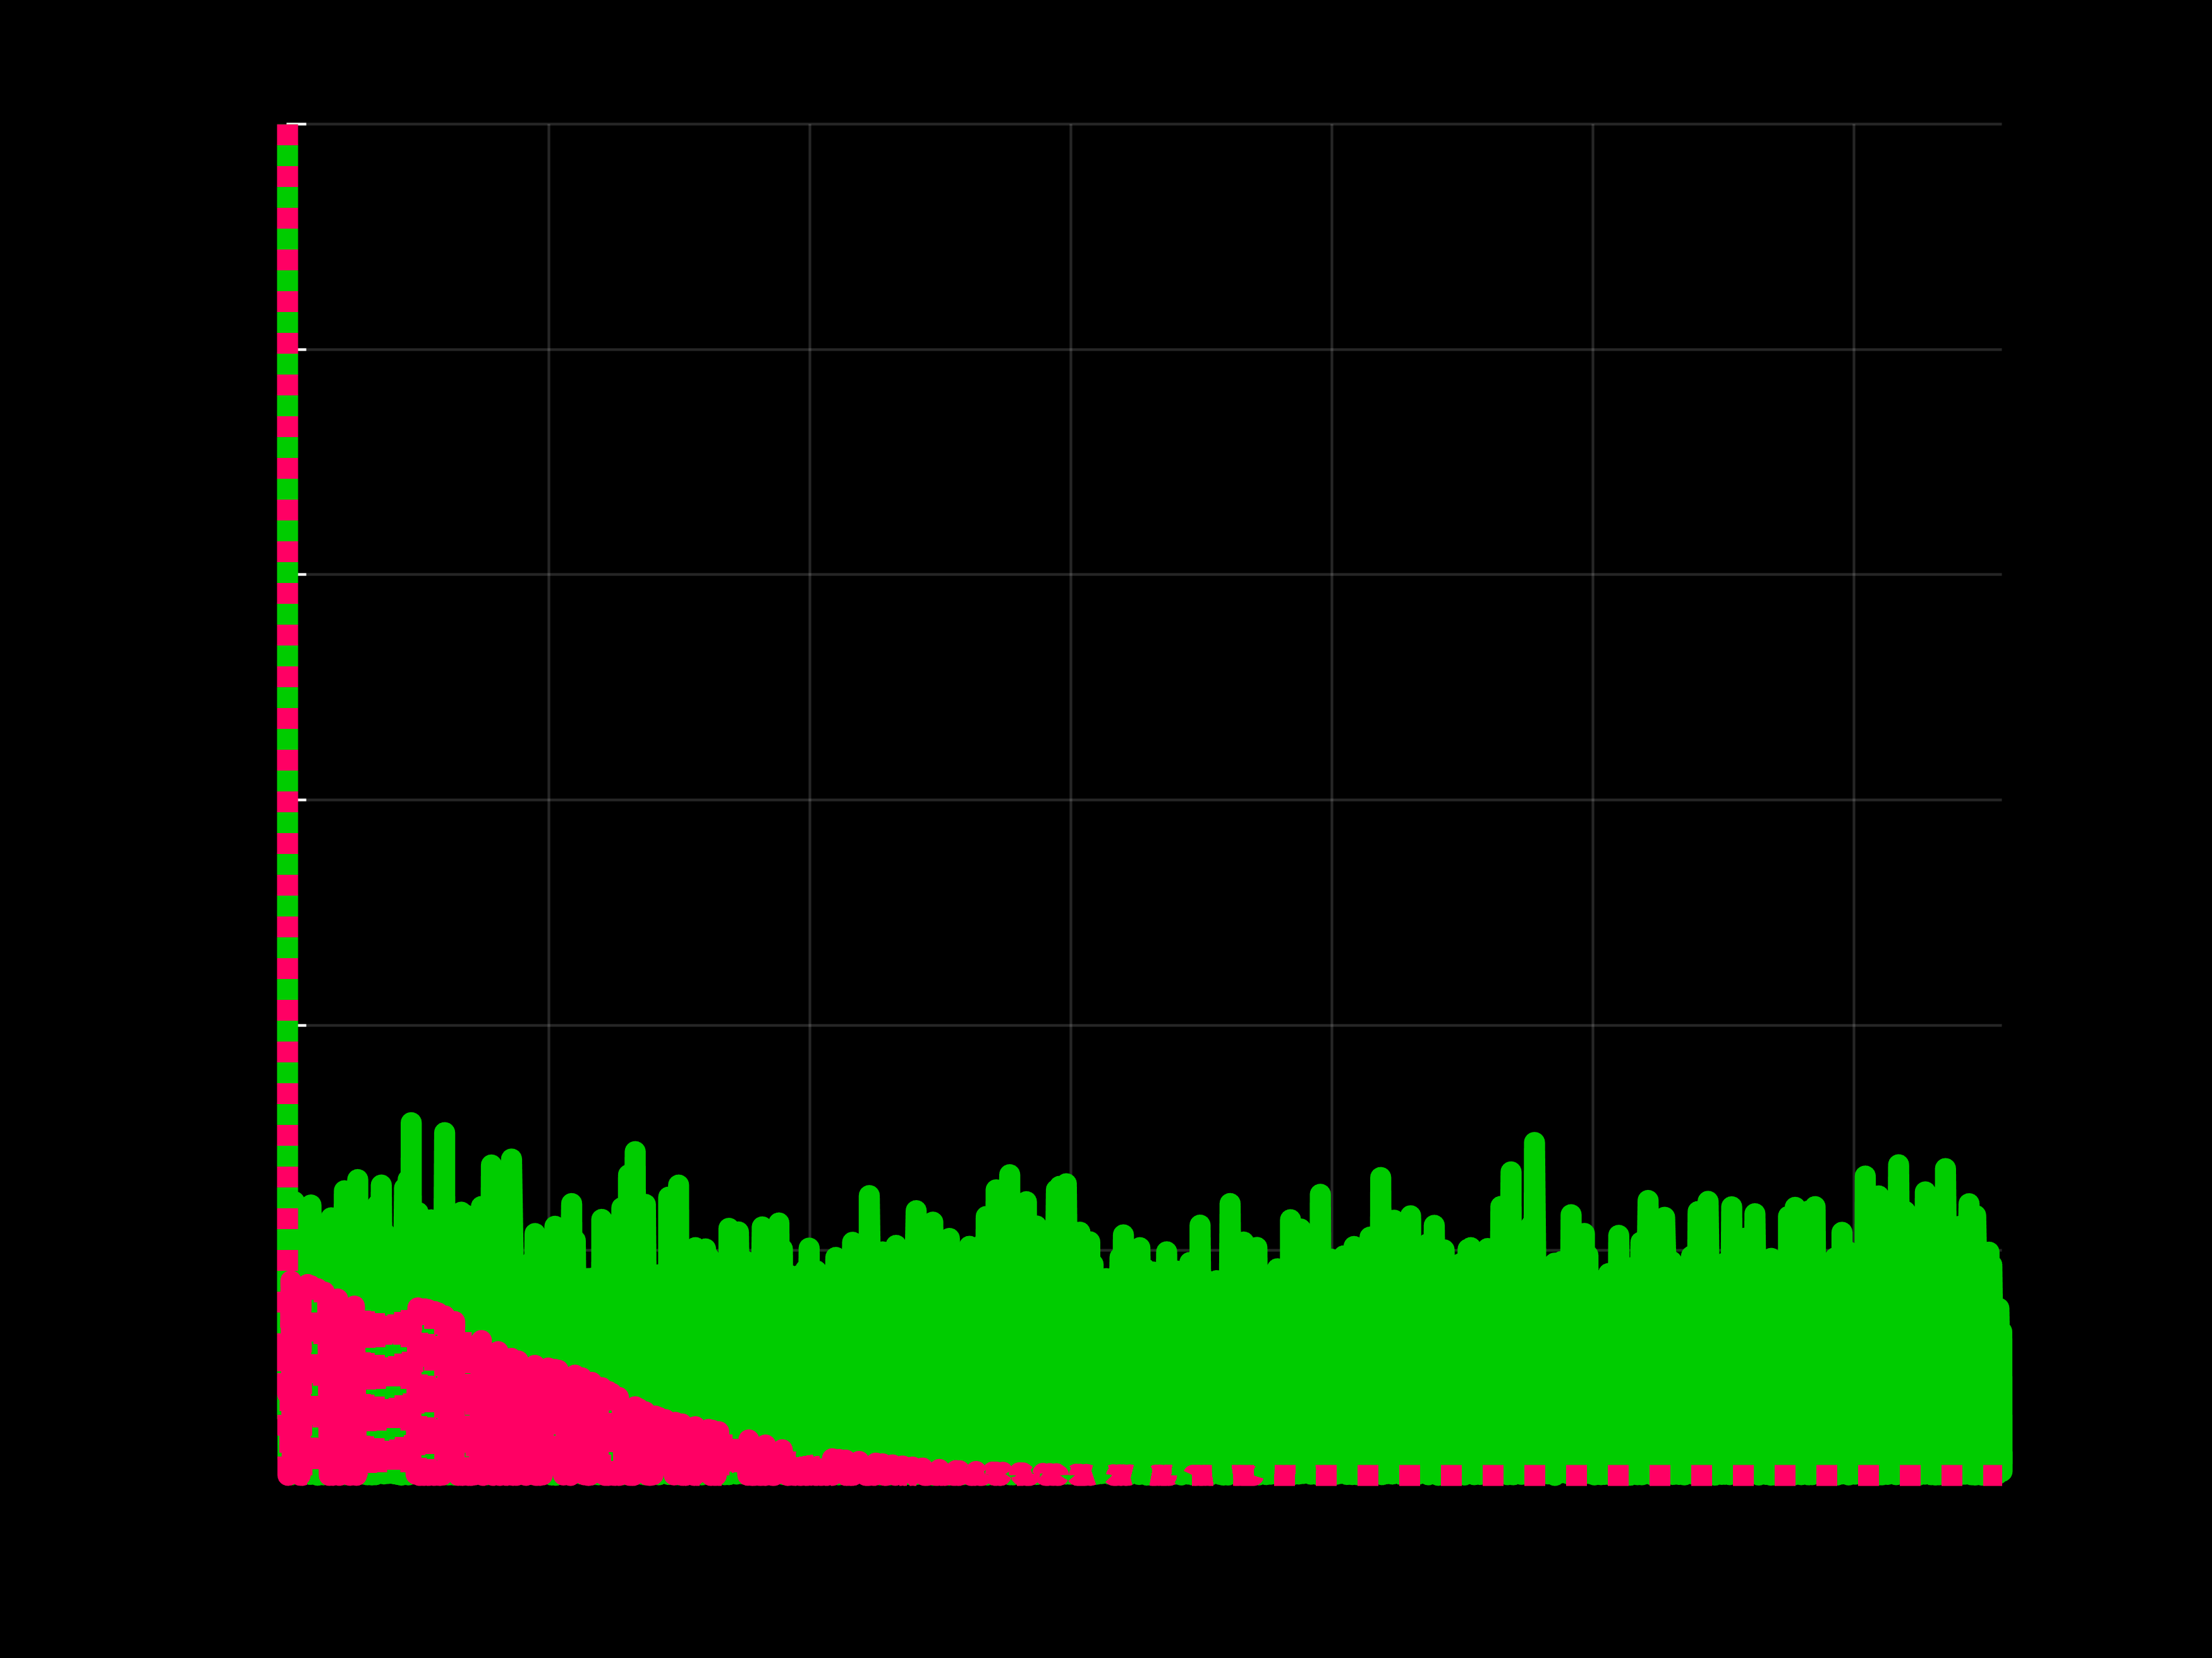
Pilot Signal Estimation
Magnitude
Noise threshold
Ground-truth
Measured
Frequency
However, in very low SNR scenarios …

Slide 55
Pilot Signal Estimation
Relatively high SNR regime
Very low SNR regime
Magnitude
Magnitude
Ground-truth
Noise threshold
Noise threshold
Measured
Frequency
Frequency
In the same scene, SNR can be different pixel by pixel

Slide 56

Pilot Signal Estimation: Guided Photon Processing
3D photon cube
2D intensity
Correlations exist in spatial frequency

Slide 57

Pilot Signal Estimation: Guided Photon Processing
3D photon cube
2D intensity
FFT of
3D cubelet
FFT of
2D patch
Similar spatial frequency distributions

Slide 58

Pilot Signal Estimation: Guided Photon Processing
Noisy measurement
2D intensity
FFT of
3D cubelet
FFT of
2D patch
Similar spatial frequency distributions

Slide 59






Pilot Signal Estimation: Guided Photon Processing
$$t$$
Noisy measurement
Pseudo intensity
$$x$$
$$y$$
Sum along $t$
FFT of
3D cubelet
FFT of
2D patch
Similar spatial frequency distributions

Slide 60


Pilot Signal Estimation: Guided Photon Processing
Noisy measurement
Pseudo intensity
Sum along $t$
$$⋱$$
FFT of
3D cubelet
$$×$$
FFT of
2D patch

Slide 61

Pilot Signal Estimation: Guided Photon Processing
Noisy measurement
Estimated pilot signal
Guided photon processing

Slide 62


Pilot Signal Estimation: Guided Photon Processing
Thresholding
Very low SNR regime
Magnitude
Ground-truth
Measured
Frequency
Guided photon processing
Magnitude
Frequency
Guided photon processing works better in very low SNR regimes

Slide 63


Pilot Signal Estimation
Thresholding
Preserve signal details
Bad in very low SNR regimes
Magnitude
Frequency
Guided photon processing
Good in very low SNR regimes
Remove signal details
Magnitude
Actual pilot signal estimation is adaptive

Slide 64
Flux Recovery using Estimated SNR
Measured

Slide 65


Flux Recovery using Estimated SNR
Measured
Scale Fourier coefficients according to $W$
Recovered
$$W= \frac{SNR}{1+SNR}$$

Slide 66









Flux Recovery using Estimated SNR
Measured
Scale Fourier coefficients according to $W$
Recovered
$$W= \frac{SNR}{1+SNR}$$
$$1$$
$$1$$
Normalized intensity
Normalized intensity
$$0$$
$$0$$
$$0$$
Time bin ($80ps$)
$$300$$
$$0$$
Time bin ($80ps$)
$$300$$

Slide 67
Application Results

Slide 68










LiDAR: Various Lighting Conditions
Lighting conditions
Favorable
Low SBR
High background
Sub-photon
Working regime
Scene
$${10}^{2}$$
Favorable
$${10}^{1}$$
High background
Signal photons
Low SBR
$${10}^{0}$$
Sub-photon
Raw data
$${10}^{−1}$$
$${10}^{0}$$
$${10}^{1}$$
$${10}^{2}$$
$${10}^{3}$$
$${10}^{4}$$
Background photons

Slide 69




LiDAR: Various Lighting Conditions
Favorable
Low SBR
High background
Sub-photon
Raw data
Estimated depth
Ground-truth depth

Slide 70




LiDAR: Various Lighting Conditions
Favorable
Low SBR
High background
Sub-photon
CASPI (ours)
CASPI (ours)
Estimated depth
Ground-truth depth

Slide 71












LiDAR: Comparisons in Outdoor Conditions
Scene
Ground-truth depth
$$100 m$$
Depth
$$3 m$$
Statistical approach
Learning-based (with intensity)
CASPI
$$100 m$$
Depth error
$$0 m$$
Error map
Error map
Error map
Can recover distant objects under bright sunlight

Slide 72










LiDAR: Varying Signal Flux
SBR:
$$24/0$$
$$2.4/0$$
$$0.8/0$$
Ground-truth depth
Scene
Measured

Slide 73



LiDAR: Varying Signal Flux
SBR:
$$24/0$$
$$2.4/0$$
$$0.8/0$$
Ground-truth depth
Scene
Measured
CASPI

Slide 74




LiDAR: Varying Signal Flux
SBR:
$$24/0$$
$$2.4/0$$
$$0.8/0$$
Ground-truth depth
Scene
Measured
CASPI
Can recover 3D geometry even in sub-photon regime

Slide 75



LiDAR: Recover Non-Gaussian Pulse
Intensity
Ground-truth IRF
Measured
Time
Intensity
Time
CASPI
Intensity
Time
Can recover non-Gaussian pulse

Slide 76


LiDAR: Recover Non-Gaussian Pulse
Ground-truth depth
CASPI
Learning-based
Statistical
Assume Gaussian pulse
Conventional approaches assuming Gaussian IRF can fail with non-Gaussian IRF

Slide 77




LiDAR: High Background
High background light
Scene
Ground-truth depth
Measured
CASPI
Can handle pileup distortion successfully in practice

Slide 78



FLIM with 10 Photons/Pixel
Spatial binning + MLE + BM3D
$$1.5 ns$$
$$3.4 ns$$

Slide 79





FLIM with 10 Photons/Pixel
Spatial binning + MLE + BM3D
CASPI
Ground-truth
$$1.5 ns$$
$$3.4 ns$$
$$1.5 ns$$
$$3.4 ns$$
$$1.5 ns$$
$$3.4 ns$$

Slide 80






FLIM with 10 Photons/Pixel
Spatial binning + MLE + BM3D
CASPI
Ground-truth
$$<2.0 ns$$
$$2.0 −2.5 ns$$
$$>2.5 ns$$
Nucleus and background segmented correctly

Slide 81






Autofluorescence (40 photons/pixel)
Linear fitting
CASPI
$$1.1 ns$$
$$2.0 ns$$
$$1.1 ns$$
$$2.0 ns$$
Reliable lifetime estimates for video-rate, live-cell FLIM

Slide 82


Autofluorescence (30 photons/pixel)
Spatial binning + MLE
CASPI
$$1.1 ns$$
$$2.0 ns$$
$$1.1 ns$$
$$2.0 ns$$
Better than off-the-shelf software (SPCImage)

Slide 83






CASPI: General Purpose Photon Processing
LiDAR
$$⋯$$
FLIM
(and more)
$$2.17 m$$
$$2.0 ns$$
$$1.40 m$$
CASPI
$$1.1 ns$$
$$2.17 m$$
$$2.0 ns$$
$$1.40 m$$
$$1.1 ns$$

